Slide 1
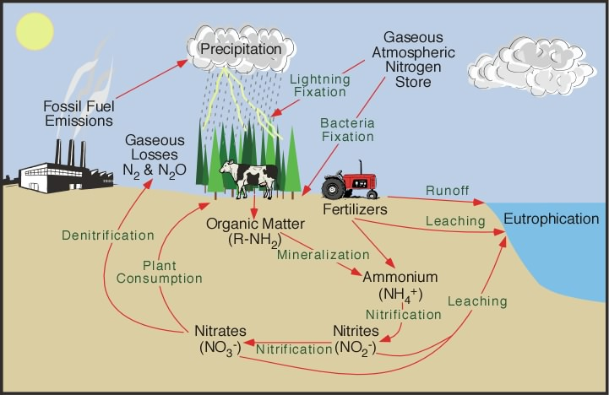
The Nitrogen Cycle

Slide 2
Nitrogen forms an essential part of amino acids (which make up proteins) and DNA (hereditary material found in all living things)
The movement of nitrogen through ecosystems, the soil, and the atmosphere is called the nitrogen cycle.
78% of atmosphere is nitrogen. Living things cannot get it directly from the air because nitrogen gas is too stable to react inside the organism to make new compounds.
Nitrogen needs to be changed into a more reactive form so that plants can use it. N2 gets fixed into ammonium (NH4) and nitrate (NO3)

Slide 3
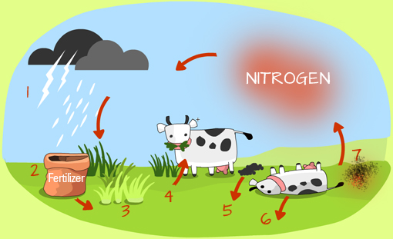
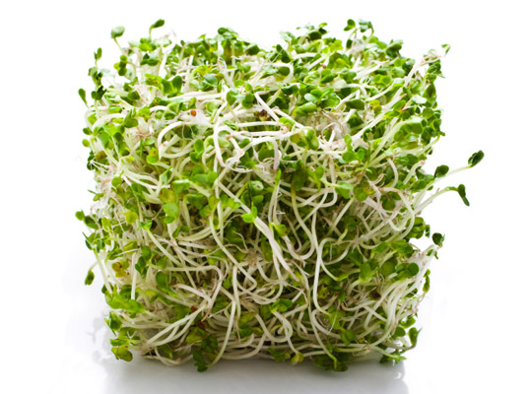
Nitrogen fixation is when atmospheric or dissolved nitrogen is converted into nitrate ions.
Nitrogen fixation happens in three different ways:
Lightning – the energy from the lighting splits the nitrogen molecule in the air allowing each nitrogen atom to react with oxygen to form nitrogen oxides. These oxides are washed to the ground by the rain where they from nitrates.
The Haber process is used by industry to produce ammonia from nitrogen. Ammonia is used to make fertilizer for farmers to feed their crops.
Nitrogen-fixing bacteria found in the soil and in nodules on the roots of legumes such as clover, soybean, peas and alfalfa.

Slide 4
Nitrogen compounds are returned to the soil be excretion and egestion from animals or when plants and animals die and decay. The nitrogen compounds returned in this way are converted to nitrogen gas by denitrifying bacteria, which live in the soil – thus completing the cycle.

Slide 5
Denitrification
is an anaerobic biological process in which nitrates are converted to nitrites (NO2) and then to nitrogen gas, which returns to the atmosphere.
Bacteria that do not require oxygen carry out denitrification.
Denitrification acts to balance nitrates, nitrites, and atmospheric nitrogen in the soil, and completes the nitrogen cycle.
Older lawns often have many denitrifying bacteria.
Exposing the denitrifying bacteria to oxygen reduces the breakdown of bitrates into nitrogen gas.
Denitrification process speeds up when the soil is acidic or water-logged (oxygen content is low)
Bogs, are well know for their lack of useful nitrogen. They can support plants that are able to live with low levels of nitrogen.

Slide 6
Agriculture and Nutrient Cycles
Fertilizers are materials used to restore nutrients and increase production from land.
High levels of nitrates may result in an increase in the amount of nitric acids in the soil.
An annual application of fertilizers between 6 and 9 kg/ha of nitrogen fertilizer can, in 10 years, produce a soil that is 10 times more acidic.
Eutrophication
- Excess fertilizer runs into near by ponds and lakes causing algal bloom. All the bloom begins to die and decompose. Oxygen levels fall because of high rate of decompostion. Fish can not survive in low levels of oxygen. Decomposition slows down due to no oxygen. Pond gradually fills in.

Slide 7
Phosphorous Cycle
Phosphorous cycle is the cycling of phosphorous between the biotic and abiotic components of the environment; consists of a biological and geochemical cycle.
Phosphorous cycle has two parts: a long-term cycle involving the rocks of Earth’s crust, and a short-term cycle involving living organisms.
Phosphorous is a key element in cell membranes, in molecues that help release chemical energy, in the making of DNA, and in the calcium phosphate of bones.
Phosphorous is most commonly found in rock formations and ocean sediments as phosphate salts. Phosphate salts that are released from rocks through weathering usually dissolve in soil water and will be absorbed by plants. Animals absorb phosphates by eating plants or plant-eating animals.
Phosphorous cycles through plants and animals much faster than it does through rocks and sediments. When animals and plants die, phosphates will return to the soils or oceans again during decay. After that, phosphorous will end up in sediments or rock formations again, remaining there for millions of years. Eventually, phosphorous is released again through weathering and the cycle starts over.

Slide 8
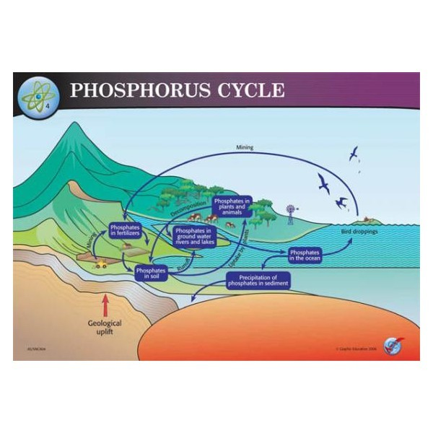

Slide 9
Variations in Nutrient Cycling
The rate of cycling nutrients is linked to the rate of decomposition.
Cycling in cooler forests takes and average of 4-6 years.
In cooler tundra, nutrient cycling takes up to 50 years.
In oxygen-poor environment of most lakes, cycling may take even longer.
Temperature and oxygen levels are the two most important abiotic factors regulating decomposition.
Other factors, such as soil chemistry and the frequency of fire, also affect decomposition and cycling.

