Slide 1
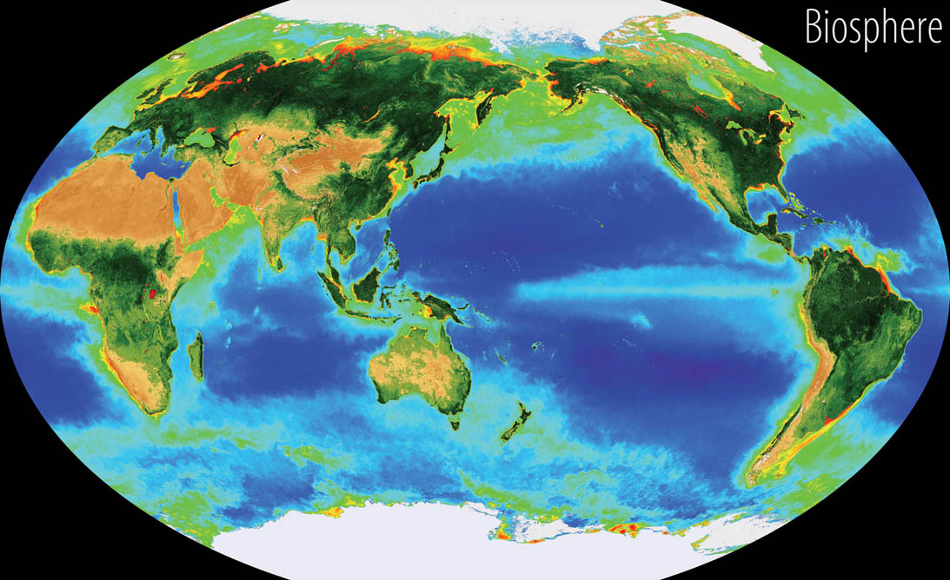
The Biosphere

Slide 2
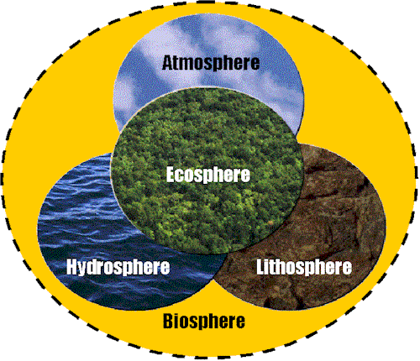
The _________________ is a mixture of nitrogen and oxygen and other gases that extend 800 km about Earths Surface. Most of the atmosphere is concentrated in the lower two parts: - the troposphere (0 – 12 km) and - the stratosphere (13 – 50 km)
The ______________ is Earth’s crust that forms
- land (continental crust) above sea level and at
the ocean bottom (oceanic crust).
- the lithosphere varies in thickness from 100 km to 200 km
The ______________ is water on or near Earth’s surface. This includes water in oceans, rivers, lakes, streams, and underground reservoirs.

Slide 3
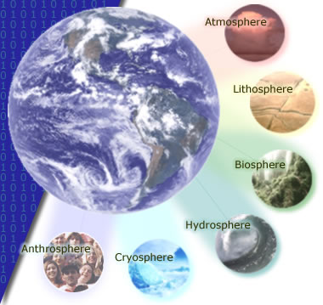
Another component within the hydrosphere is the _____________. It consists of water that is temporarily frozen in polar ice caps, snow, permafrost, and glaciers.
_______________ – the part of the environment made or modified by humans and used for their activities Ex., human populations, its buildings, dams and other constructions.

Slide 4
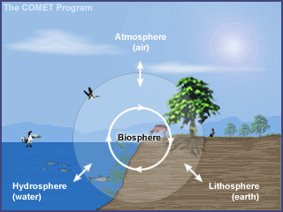
The biosphere,
_________________________________________________ It occupies a thin layer of air (atmosphere), water (hydrosphere), and land (lithosphere). Living organisms are found in all three zones.

Slide 5
Closed system –
Dynamic equilibrium –
homeostasis –

Slide 6
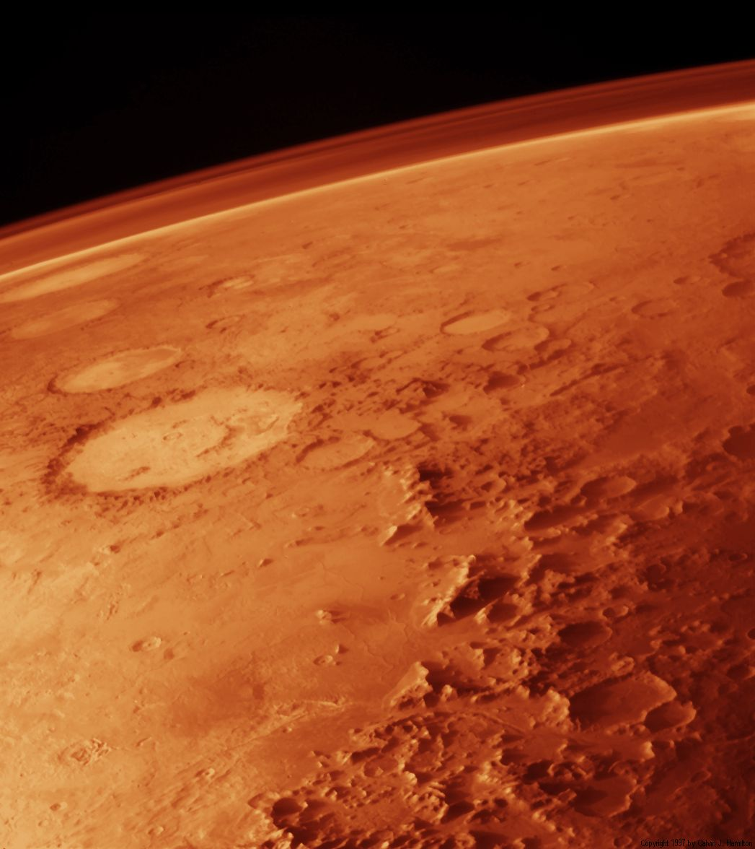
An atmosphere in ____________________ (like that of Mars) indicates a dead world. All the reactions have taken place and the elements have found their most stable chemical form. The atmosphere of a living planet, like ours, is quite different. Unstable, interesting, and improbable reactions happen all the time, thanks to cycles!

Slide 7
Components of the biosphere can be:
Biotic –
Abiotic –

Slide 8
Species –
Population –
Community –

Slide 9
Ecosystem –
e.g., A forest is a common ecosystem. Forests consist of air, soil, water, nutrients, and particular species of animals, birds, insects, microorganisms, trees, and other plant life. If some of the trees are cut down, each of the other elements will be affected. Animals and birds may lose their habits, soil may erode, nutrients may be displaced, and the flow of waterways may change.

Slide 10
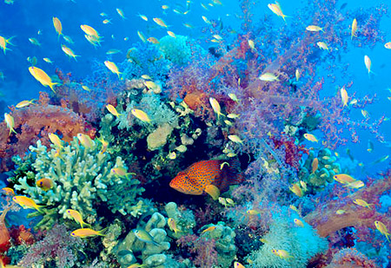
Biodiversity (biological diversity)

Slide 11
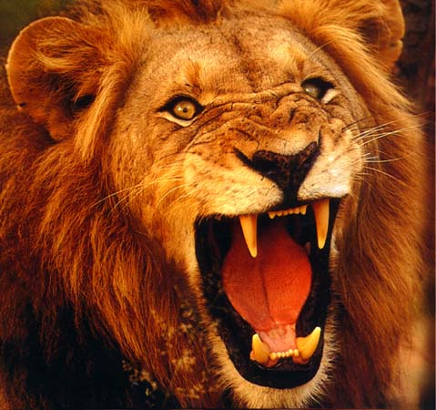
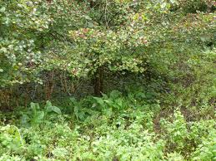
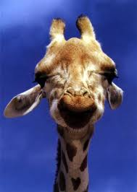
FOOD CHAIN
Always starts with plant life (_____________) and ends with an animal (_____________).
For example, a simple food chain links the trees and shrubs, the giraffes (that eat the trees and shrubs), and the lions (that eat the giraffes).

Slide 12
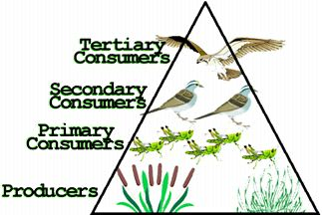
Plants are called ______________ because they are able to use light energy from the sun to produce food (sugar) from carbon dioxide and water.
Animals cannot make their own food so they must eat plants and/or other animals. They are called ______________. There are three groups of consumers.
Animals that eat ONLY PLANTS are called herbivores (or primary consumers).
Animals that eat OTHER ANIMALS are called carnivores.
Carnivores that eat herbivores are called SECONDARY CONSUMERS
Carnivores that eat other carnivores are called TERTIARY CONSUMERS
Ex., phytoplankton -> small fishes -> seals -> killer whales
Animals and people who eat BOTH animals and plants are called omnivores.

Slide 13
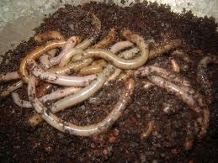
Then there are ______________ (bacteria and fungi) which feed on decaying matter.
These decomposers speed up the decaying process that releases mineral salts back into the food chain for absorption by plants as nutrients.

Slide 14
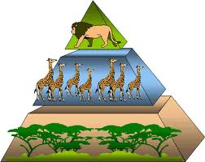
The above energy pyramid shows many trees and shrubs providing food and energy to giraffes. Note that as we go up, there are fewer giraffes than trees and shrubs and even fewer lions than giraffes … as we go further along a food chain, there are fewer and fewer consumers.

Slide 15
Domino effect –
Predator-Prey relationship
A predator
A prey
Note:
Examples of predator and prey are lion and zebra, bear and fish, and fox and rabbit.

Slide 16
Page 10, 1-8

