Slide 1
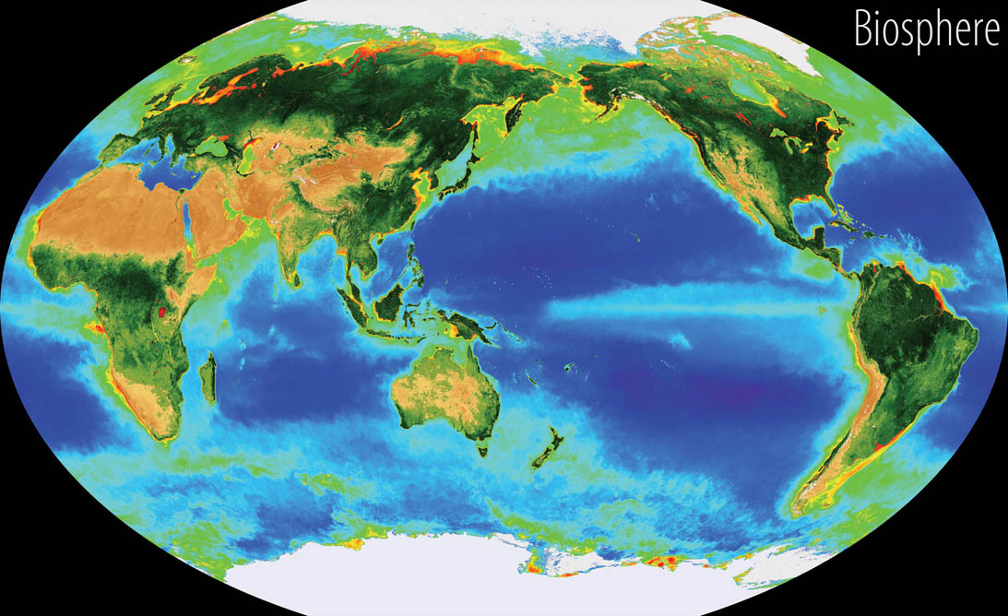
The Biosphere

Slide 2
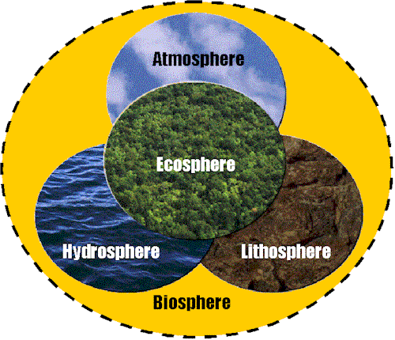
The atmosphere is a mixture of nitrogen and oxygen and other gases that extend 800 km about Earths Surface. Most of the atmosphere is concentrated in the lower two parts: - the troposphere (0 – 12 km) and - the stratosphere (13 – 50 km)
The lithosphere is Earth’s crust that forms
- land (continental crust) above sea level and at
the ocean bottom (oceanic crust).
- the lithosphere varies in thickness from 100 km to 200 km
The hydrosphere is water on or near Earth’s surface. This includes water in oceans, rivers, lakes, streams, and underground reservoirs.

Slide 3
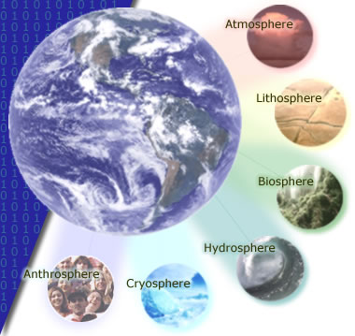
Another component within the hydrosphere is the cryosphere. It consists of water that is temporarily frozen in polar ice caps, snow, permafrost, and glaciers.
Anthrosphere – the part of the environment made or modified by humans and used for their activities Ex., human populations, its buildings, dams and other constructions.

Slide 4
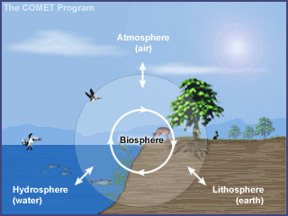
The biosphere,
is the portion of earth in which all known life forms exist. It occupies a thin layer of air (atmosphere), water (hydrosphere), and land (lithosphere). Living organisms are found in all three zones.

Slide 5
Closed system – a system that allows energy but not matter to cross the system’s boundary
Dynamic equilibrium – when a system is constantly moving and changing – substances enter and leave the atmosphere, but whose components adjust to changes without disturbing the entire system.
homeostasis – stability while adjusting to conditions that are optimal for survival. If homeostasis is successful, life continues; if unsuccessful, disaster or death ensues. The stability attained is actually a dynamic equilibrium, in which continuous change occurs yet relatively uniform conditions prevail.

Slide 6
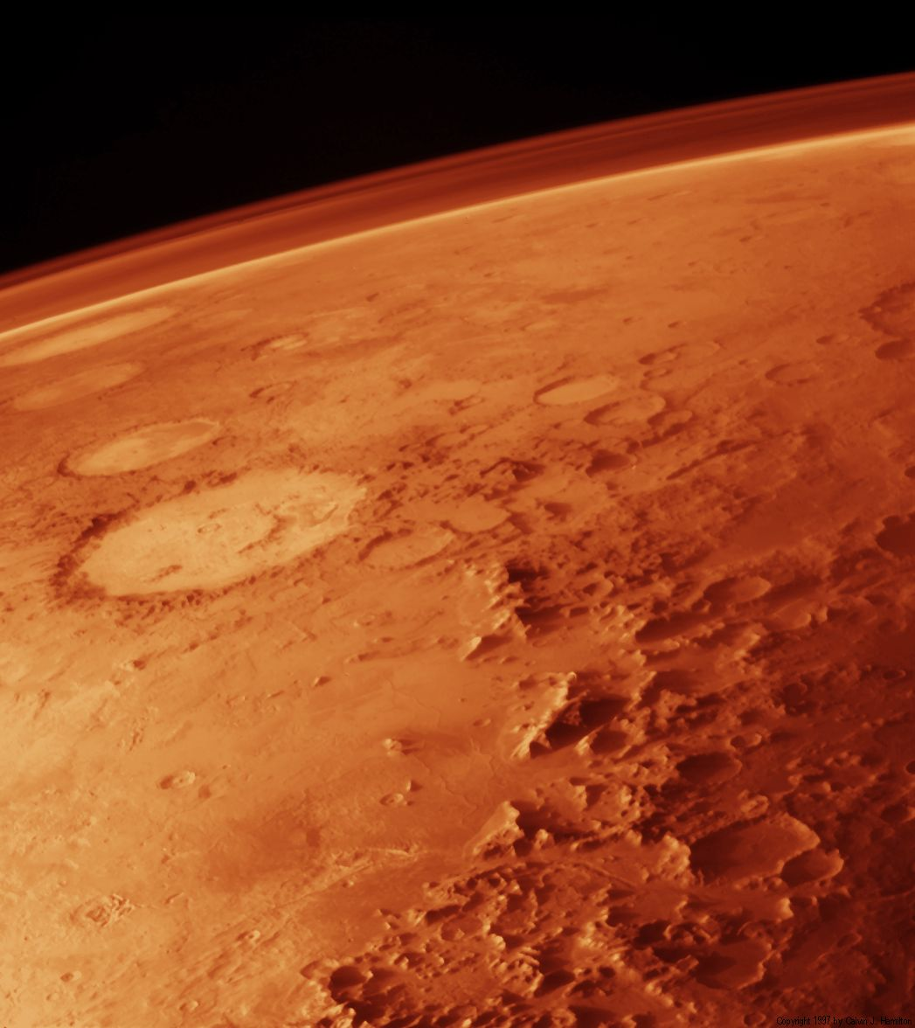
An atmosphere in static equilibrium (like that of Mars) indicates a dead world. All the reactions have taken place and the elements have found their most stable chemical form. The atmosphere of a living planet, like ours, is quite different. Unstable, interesting, and improbable reactions happen all the time, thanks to cycles!

Slide 7
Components of the biosphere can be:
Biotic – living factors, e.g., plants, animals, fungi, protist and bacteria
Abiotic – non-living factors, e.g. rocks, minerals, physical factors (temperature, weather)

Slide 8
Species – group of organisms capable of breeding and producing fertile off spring
Population – is a group of individuals of the same species within a given space and time
Community – consists of a collection of populations of different species (populations) interacting within a specific area

Slide 9
Ecosystem - a community of living and nonliving things considered as a unit.
e.g., A forest is a common ecosystem. Forests consist of air, soil, water, nutrients, and particular species of animals, birds, insects, microorganisms, trees, and other plant life. If some of the trees are cut down, each of the other elements will be affected. Animals and birds may lose their habits, soil may erode, nutrients may be displaced, and the flow of waterways may change.

Slide 10
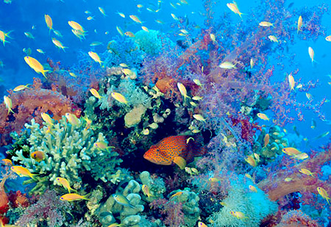
Biodiversity (biological diversity)
A variation of life forms within a given ecosystem.
The number and variety of organisms in a given area.

Slide 11
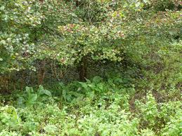
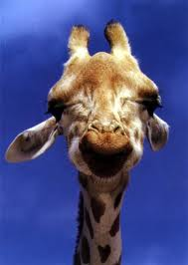
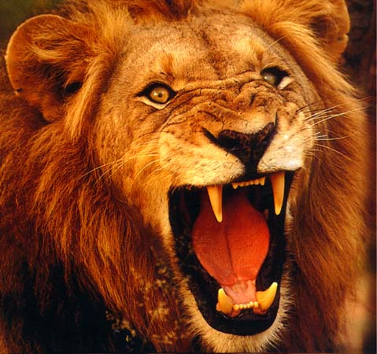
FOOD CHAIN
Shows how each living organism gets its food.
Always starts with plant life (producers) and ends with an animal (consumer).
For example, a simple food chain links the trees and shrubs, the giraffes (that eat the trees and shrubs), and the lions (that eat the giraffes).

Slide 12
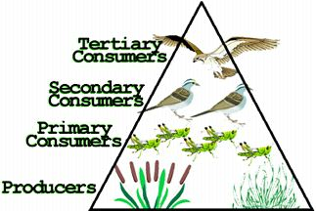
Plants are called producers because they are able to use light energy from the sun to produce food (sugar) from carbon dioxide and water.
Animals cannot make their own food so they must eat plants and/or other animals. They are called consumers. There are three groups of consumers.
Animals that eat ONLY PLANTS are called herbivores (or primary consumers).
Animals that eat OTHER ANIMALS are called carnivores.
Carnivores that eat herbivores are called SECONDARY CONSUMERS
Carnivores that eat other carnivores are called TERTIARY CONSUMERS
Ex., phytoplankton -> small fishes -> seals -> killer whales
Animals and people who eat BOTH animals and plants are called omnivores.

Slide 13
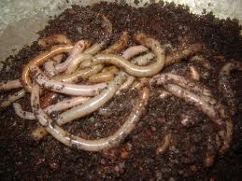
Then there are decomposers (bacteria and fungi) which feed on decaying matter.
These decomposers speed up the decaying process that releases mineral salts back into the food chain for absorption by plants as nutrients.

Slide 14
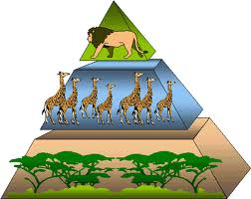
The above energy pyramid shows many trees and shrubs providing food and energy to giraffes. Note that as we go up, there are fewer giraffes than trees and shrubs and even fewer lions than giraffes … as we go further along a food chain, there are fewer and fewer consumers.

Slide 15
Domino effect – is a simple chain reaction that occurs when a small change causes a similar change nearby, which then will cause another similar change, and so on in linear sequence.
Predator-Prey relationship
A predator is an organism that eats another organism.
A prey is the organism which the predator eats.
Note:
When a species acts as a predator, it keeps the population of its prey in check.
When a species acts as a prey, it provides an important food source.
Examples of predator and prey are lion and zebra, bear and fish, and fox and rabbit.

Slide 16
Page 10, 1-8

