Slide 1
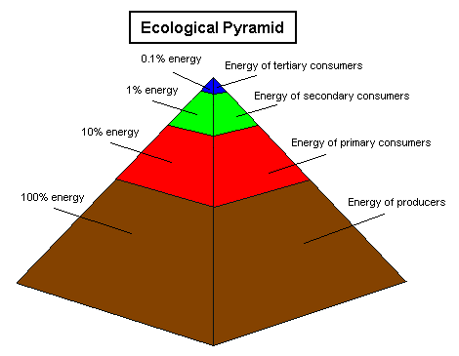
Scientific Models
REVIEW ->
http://youtu.be/cWh-XKhh8xo
Ecological Pyramid –

Slide 2
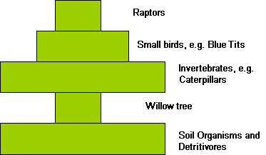
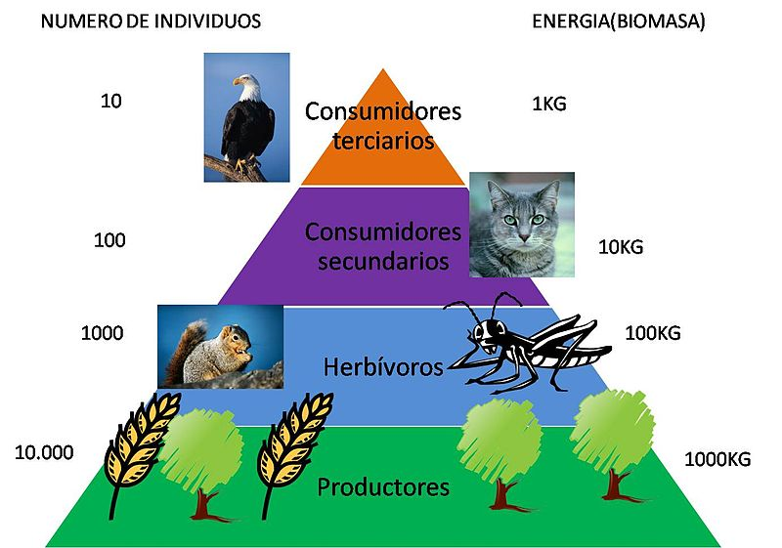
Pyramid of Numbers –
____________________________________
____________________________________
____________________________________
If the producer is a large plant such as an oak
tree, the second layer of the pyramid
representing primary consumers (caterpillars)
will be much larger than the base. In this
case it would make more sense to draw
a pyramid of biomass.

Slide 3
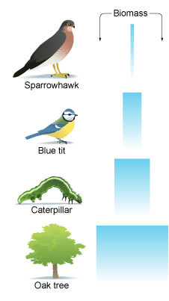
Pyramid of biomass –
A pyramid of biomass for the oak tree would look like this:
Biomass
Pyramid of biomass is more accurate than a pyramid
Of numbers.

Slide 4
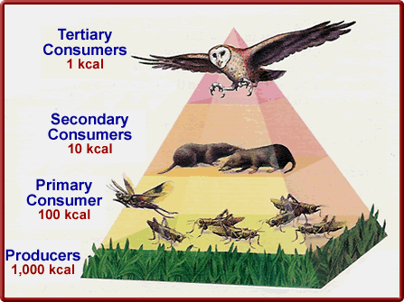
Pyramid of Energy –
Watch video:
http://youtu.be/De_53QflEXQ

Slide 5
Human Use of Energy in Ecosystems
Hunting, fishing, and extensive crop growth have impacted many large ecosystems → changes the types and sizes of populations of organisms.
Cultivation of land has disrupted many food chains. In Alberta, this contributed to a decline in the populations of mule deer, bison, elk, and moose, while increasing the number of whitetail deer.
Overhunting of wild species such as wolves and buffalo lead to extirpation (almost eliminated completely) and large changes in the ecosystem.
Short-term economic gain at the expense of long-term economic collapse resulted from overfishing.

Slide 6
Monocultures
Tropical rain forests are not well suited for monocultures of grains such as wheat and barley.
Greatest biodiversity exists in the tropical rain forests.
Many wild plants important for medicinal purposes have been destroyed to grow food crops, especially in tropical rain forests.
Examples of monoculture include lawns and most field crops, such as wheat or corn or apple orchards or grape vineyards.
Monoculture produces great yields by utilizing plants’ abilities to maximize growth under less pressure from other species and more uniform plant structure.

Slide 7
Monocultures have a greater drain on soil nutrients.
Monocultures are extremely sensitive to attack.
Monocultures consist of identical plants with identical defenses.
A disease or infestation can devastate a monoculture, rendering the entire forest or fields worthless.
In a monoculture, every adjacent plant is an inviting host, waiting for an attacker to get lucky.

