Slide 1
Objectives
Students will:
Describe the chemical nature of carbohydrates, lipids and proteins
Be able to define and explain how dehydration synthesis and hydrolysis assemble and disassemble macromolecules

Slide 2
Chemicals of Life
Vitamins and Minerals
Help in chemical reactions
Often found in complex chemicals
Micronutrients
Lipids (fats)
Energy storage compound
Structural component of cell membranes
Macronutrients
Carbohydrates
Primary energy source of cells
Structural material of plant cell walls
Proteins
Structural components of the cell
Composed of amino acids
Nucleic Acids
Genetic material that directs cell activity
Composed of sugar, phosphate, and nitrogen bases

Slide 3
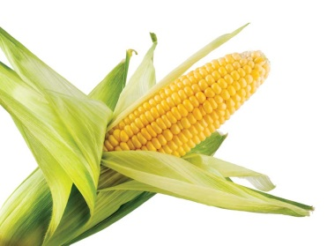
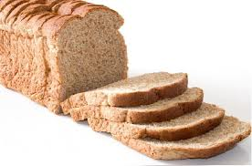
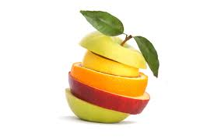
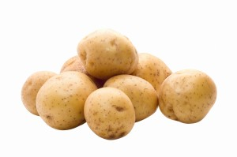
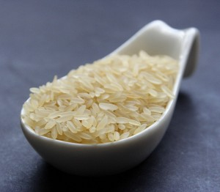
Carbohydrates
Provide fast source of energy and make up the largest components in most diets
Ex., potatoes, bread, corn, rice and fruit
our body is unable to make them, we need to rely on plants
They are macromolecules that always contain
carbon, hydrogen and oxygen; almost always in same
proportions:
2 atoms of hydrogen and 1 atom of oxygen
For every atom of carbon
Large molecule created
by smaller subunits
See p 243 of your text.

Slide 4
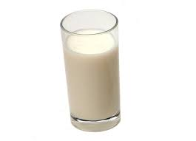
Carbohydrates are classified according to the number of sugar units they contain:
Monosaccharide’s – single molecule of sugar
ex., glucose, fructose, galactose
Simple sugars
Disaccharides – 2 molecules of sugar
ex., maltose = glucose + glucose (found in seeds of germinating plants)
sucrose = glucose + fructose (white sugar extracted from plants like sugar cane and
sugar beet)
lactose = glucose + galactose (milk sugar)
Polysaccharides – 3 or more molecules of sugar
ex., plants → starch (stored energy in plants), cellulose (make up plant cell walls)
humans → glycogen (stored energy in animals)
Complex sugars

Slide 5
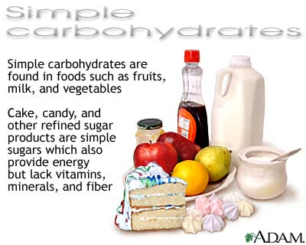

Slide 7
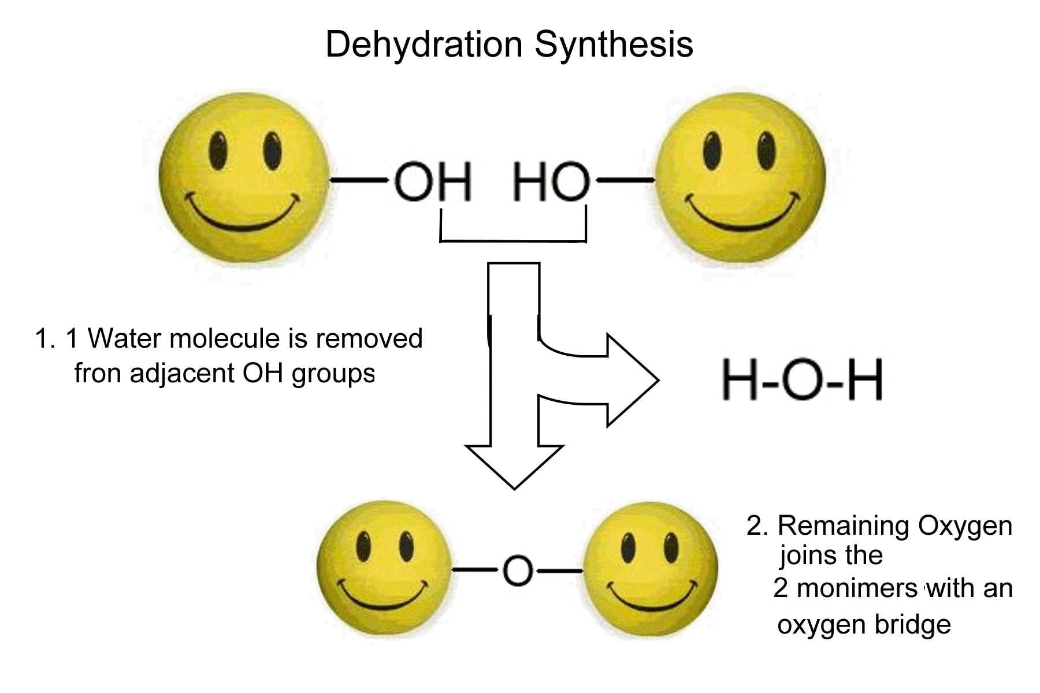
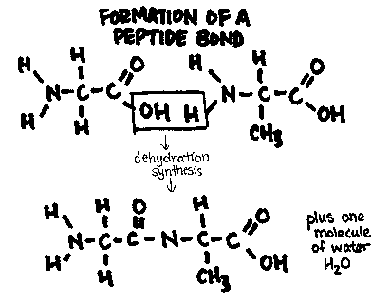
Formation of Macromolecules:
All assembled in the cell the same basic way.
Dehydration Synthesis (assembling macromolecules)
To form a covalent bond between two subunit molecules an
–OH (hydroxyl) group is removed from one subunit and a hydrogen atom
is removed from the other subunit
Removing the –OH group and H atom during the synthesis of a new
Biological molecule essentially removes a molecule of water

Slide 8
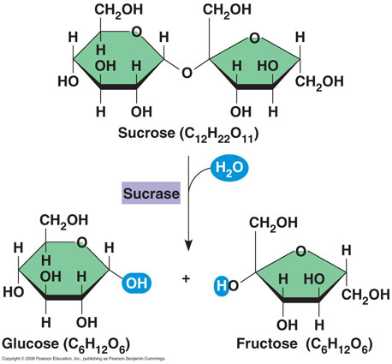
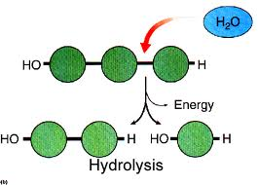
B) Hydrolysis (disassembling macromolecules)
A molecule of water is added instead of removed
A hydrogen atom from water is attached to one subunit and the hydroxyl group is bonded to another subunit effectively breaking a convalent bond in a macromolecule.
Both processes are carried out in the cell and involve enzymes.

Slide 9
During the synthesis of sucrose, a chemical bond forms between glucose and fructose molecules, and the components of one water molecule are removed. During the hydrolysis of sucrose, the components of one water molecule are added and the bond is broken, yielding glucose and fructose molecules.

Slide 10
Lipids
Diverse group of macromolecules – all are insoluble in water
Store 2.25 times more energy per gram than other biological molecules
Functions
Energy – storage molecules
Key components of cell membranes (phospholipids)
Form sex hormones (estrogen and testosterone)
Layer at base of skin helps insulate you
Act as cushions for delicate organs
Carriers for vitamin A, D, E, and K

Slide 11
a) Saturated - animal fats – ex., butter, lard - solid at room temperature - hard to break down - single bonds between carbons see figure 7 on p246
Unsaturated
- liquid at room temperature – ex., vegetable oils (olive, sunflower)
- double bonds between carbons
Cholesterol
- waxy, fat like substance
- found naturally in membranes
- builds and maintains membranes; regulates membrane fluidity
- different types – not all bad
-- atherosclerosis
- disorder of blood vessels
- accumulation of cholesterol and other fats along the inside lining

Slide 12
Read the Case Study “Fats and Health”
on p 248 and answer the questions that follow.

Slide 13
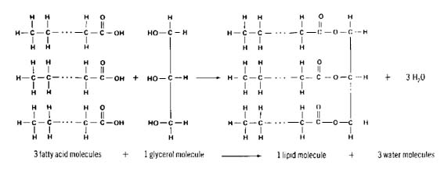
Formation of lipids:
During the synthesis of a fat molecule, three fatty acid molecules bond with one glycerol
Molecule, and three water molecules are produced.
Explain what happens during the hydrolysis of a fat molecule.

Slide 14
Proteins
Structural component of cells
Ex., muscle, hair, nails, nerves, cell membrane
Mitochondria and ribosomes are composed largely of protein
Antibodies are specialized proteins that help the body defend
Itself against disease
Enzymes are proteins that speed up chemical reactions.
Contain carbon, hydrogen, oxygen, nitrogen and often sulfur
atoms
Can supply energy for tissues but not their main function
Made up of 20 amino acids. 11 of which can be synthesized
by the body and nine (essential amino acids) which must come
from the diet

Slide 15
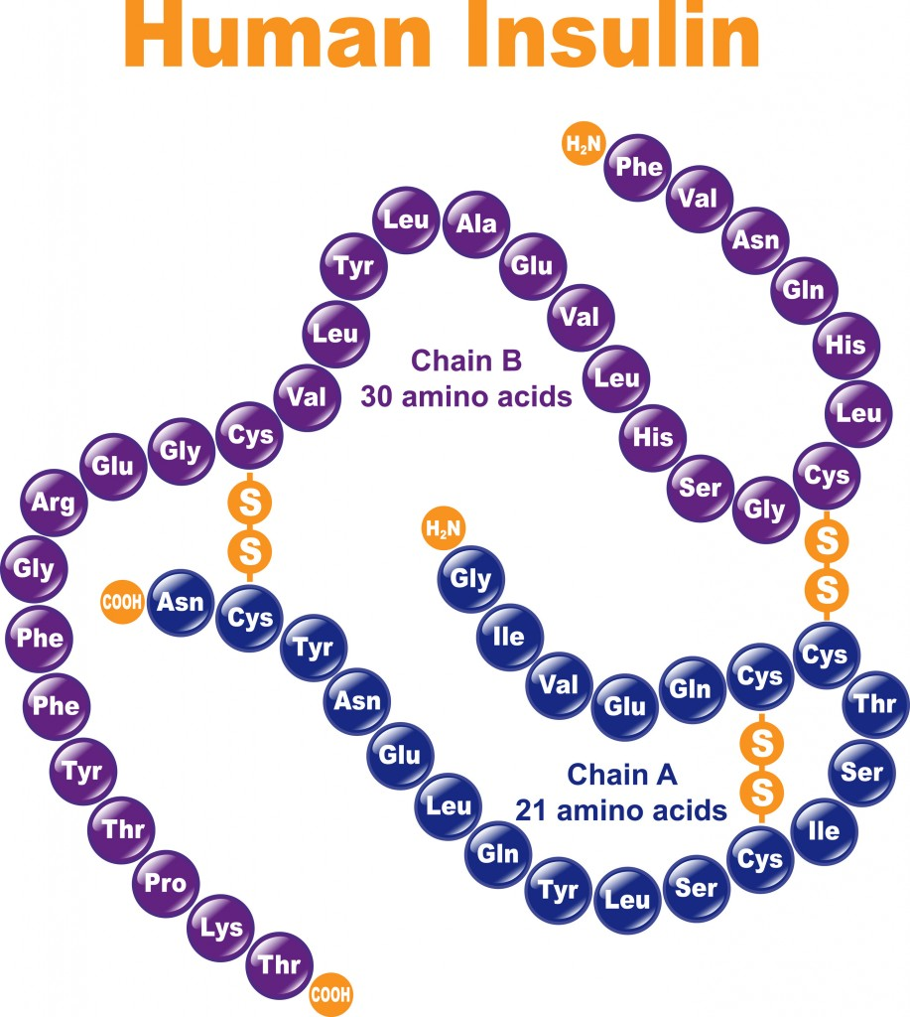
Proteins continued:
General structure of an amino acid:
Amino group (NH group)
Carboxyl group (COOH)
R group (represents a number of different structures and differentiates one amino acid from another)
Order of amino acids determines the type of protein
Polypeptides join amino acids together
A chain of three or more amino acids is called a polypeptide
A proteins shape or structure determines it function
See fig. 13 on p 251 for structure of a protein

Slide 16
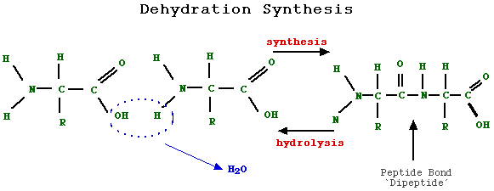
Formation of a protein:
In dehydration synthesis, two amino acids bond to form a two
subunit molecule called a dipepetide. Hydrolysis breaks the peptide
bond that links the amino acids. The R groups are shown here only
as “R”, because they do not take part in the reactions that make or
Break peptide bonds.
See also fig 12 on p250 in your text.

Slide 17
Denaturation – the process that occurs when the bonds of protein are disrupted by physical or chemical factors, causing temporary change in shape
Coagulation – the process that occurs when bonds of a protein
molecule are disrupted, causing a permanent change in shape

Slide 18
Vitamins
We only require a small amount.
NOT macromolecules but still important to the structures and function of cells.
Key components of many chemical reactions that yield energy, synthesize compounds, and break down compounds.
Organic substances
coenzymes
Chemicals needed to make enzymes function.
Involved in tissue development, tissue growth, and resistance to
disease
Minerals
Inorganic
Control water balance
Regulate acid-base balance in body
From structural part of bones and cartilage
Enable certain chemical reactions to occur
Essential components of molecules ex) hemoglobin, hormones,
enzymes and vitamins

Slide 19
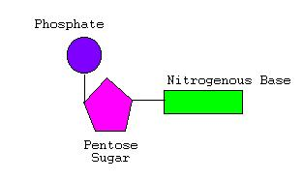
Nucleic Acids
Direct the growth and development of all organisms using a chemical code
Determines how a cell functions and what characteristics it has
Two types: DNA and RNA
Contains genes, which hold
info needed to build the cell
A gene is first copied into RNA, which
then is involved in making a protein
Consists of long chains of linked subunits (nucleotides)

Slide 20
Water
Makes up more than 60% of body
Cells must be bathed in water to enable dissolved nutrients and
waste to pass in and out of cell
We use water to cool ourselves by sweating

