Slide 1
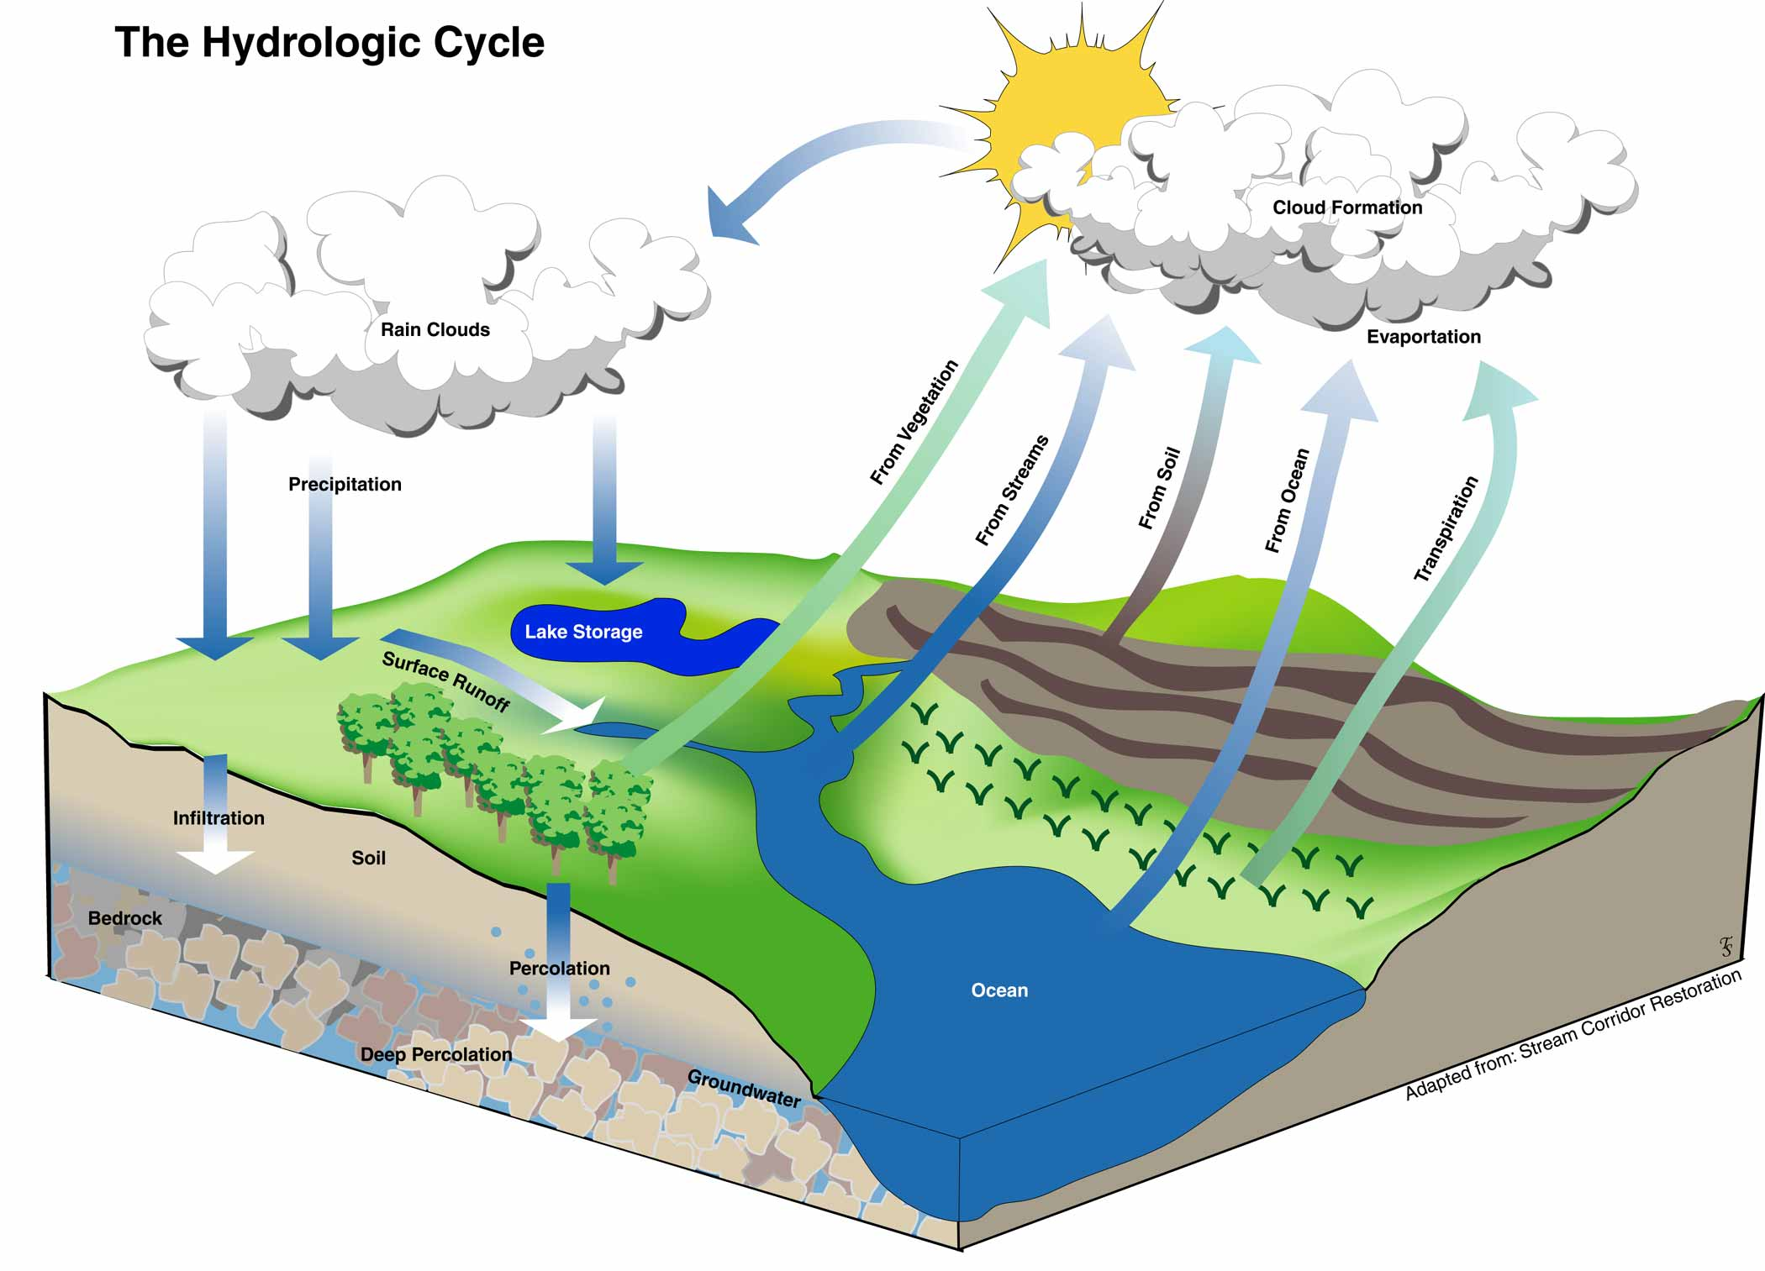
Hydrological Cycle

Slide 2
Organic compounds
Are substances that contain atoms of carbon and hydrogen.
Proteins, sugars, and fats, the important chemicals that make up your body are all organic.
Cycling of Organic Matter
Every carbon atom is recycled time and time again.
Decay is an important process involved in the cycling of matter, which may be used by plants.
Plants reassemble these inorganic substances (also called nutrients) to make food for themselves.

Slide 3
Properties of Water
Absorbs and releases thermal energy and moderates temperature fluctuations.
Is the medium in which metabolic reactions take place.
Is an excellent solvent.
Makes up over 60% of the cell’s mass.
Supplies hydrogen atoms to producers during the metabolism of key organic molecules during photosynthesis and oxygen atoms to all organisms during cellular respiration.
Is a reactant in some metabolic activities and a product in others.
http://youtu.be/HVT3Y3_gHGg

Slide 4
Water: A Polar Molecule
water is polar because it has a slightly positive end and a slightly negative end.
Water molecules are held together by covalent bonds that join one oxygen and two hydrogen atoms.
The intermolecular forces (forces between molecules) are weaker than intramolecular forces (the chemical bonds within an individual molecule) that hold the atoms in H2O molecules together.
Hydrogen bonding helps explain some of the physical properties of water (higher boiling point and melting point).
Hydrogen bond is formed between the positive end of one water molecule and the negative end of another water molecule.

Slide 5
The Hydrological Cycle (water cycle)
The movement of water through the biosphere is called the hydrological cycle (water cycle).
It is made up of the following main parts:
Evaporation
Transpiration
Condensation
Precipitation
Collection

Slide 6
Evaporation is when the sun heats up water in rivers or lakes or the ocean and turns it into vapor or steam. The water vapor or steam leaves the river, lake or ocean and goes into the air.
Transpiration is the process by which plants lose water out of their leaves. Do plants sweat? Well, sort of …. People perspire (sweat) and plants transpire.
Condensation occurs when the water vapor in the air gets cold and changes back into liquid, forming clouds.
Precipitation occurs when so much water has condensed that the air cannot hold it anymore. The clouds get heavy and water falls back to the earth in the form of rain, hail, sleet or snow.
Collection occurs when water falls back to earth as precipitation, it may fall back in the oceans, lakes or rivers or it may end up on land. When it ends up on land, it will either soak into the earth or become part of the “ground water” that plants and animals use to drink or it may run over the soil and collect in the oceans, lakes or rivers here the cycle starts.

Slide 7
Note:
Water is released back to the land or atmosphere through cellular respiration, decay of dead organisms, and transpiration
Broad leaves and shrubs play a major role in water recycling through transpiration
Where forests have been removed by logging or burning, there is less water in the atmosphere, along with noticeable climate change.
Surface runoff patterns become disturbed and the water-holding capability of the soil may be reduced.

Slide 8
Water Beneath the Soil
The fresh water that we use comes from two sources:
ground water
surface water
Surface water is precipitation that is collected above the ground, such as the water in lakes, ponds, and rivers.
Surface runoff – excessive rain or snowmelt can produce overland flow to creeks and ditches. Runoff is visible flow of water in rivers, creeks and lakes as the water stored in the basin drains out.
Ground water – depending on the geology, the groundwater can flow to support streams. It can also be tapped by wells. Some groundwater is very old and may have been there for thousands of years.

Slide 9
Percolation
The downward pull of water (by gravity)
The movement of water through a porous material such as soil particles
The larger the soil particles are, the greater the size of the pores between the particles and the faster the percolation rate
Some of the precipitation and snow melt moves downwards, percolates or infiltrates through cracks, joints and pores in soil and rocks until it reaches the water table where it becomes groundwater
Water table
Forms above a layer of relatively impermeable bedrock or clay
Is the top level of the region below the ground that is saturated with water
The greater the rainfall, the higher the water table will be
Leaching is the removal of soluble minerals by (percolation) – as water seeps downward, it carries dissolved organic matter and minerals to the lower layers of the soil
Leaching is corrected by some plants. Long branching roots extend deep into the soil and help bring minerals and other chemicals from the lowe levels of the soil back to the surface.

Slide 10
Acid Deposition and the Water Cycle
Smoke stackers of coal-burning generating stations, metal smelters, and oil refineries provide:
Energy and products for the industrial world
Oxides of sulfur and nitrogen – air pollutants
Sulfur is released in the form of sulfur dioxide (SO2) – poisonous gas
Nitrogen is released in the form of nitrous oxides (Nox)
SO2 and Nox combine with water to form acids
The acids return to the Earth in the form of snow or rain (acid rain)
Acid rain is about 40 times more acidic than normal rain
Acid rain kills fish, soil bacteria, and both aquatic and terrestrial plants
Acid rain also leaches nutrients from the soil by dissolving them in ground water
Sometimes particles of sulfur and nitrogen compounds remain airborne and settle out in the dry state called “dry deposition”
“scrubbers” is smokestacks remove much of the harmful emssions.
Lime has been added to lakes to help neutralize acids from the atmosphere.

Slide 11
The Role of Water in Nutrient Cycling
Water is an excellent solvent
Water can dissolve nutrients such as nitrates and phosphates, enabling plant roots to absorb them.
Water has strong hydrogen bonding, so it can move against gravity, carrying nutrients up plant stems and trunks to cells throughout the plant by a process called “capillary action”.
Water has a role in the cycling of carbon and oxygen
Water is also an essential factor in photosynthesis and cellular respiration

Slide 12
http://youtu.be/09_sWPxQymA
http://academic.cengage.com/biology/discipline_content/animations/sulfur_cycle.html

