Slide 1
Enzymes
Explain enzyme action and factors influencing their action
Temperature
pH
Substrate concentration
Feedback inhibition
Competitive inhibition

Slide 2
Enzyme Role
Enzyme – a protein catalyst that permits chemical reactions to proceed at low temperatures
Catalyst – a chemical that regulates the rate of chemical reactions without being altered
Cellular metabolism – all the reactions that involve the breakdown of chemicals (catabolism) or the production of chemicals (anabolism).
Most reactions require energy to start a reaction. This is called activation energy.

Slide 3
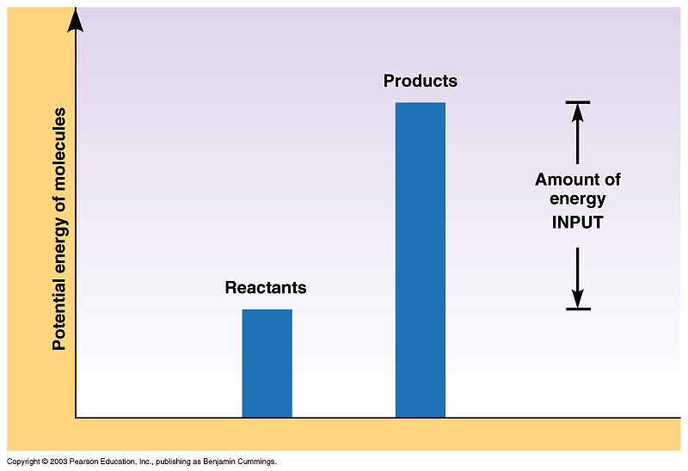
Chemical Reactions
Endergonic
Requires energy
Products have more energy than the reactants

Slide 4
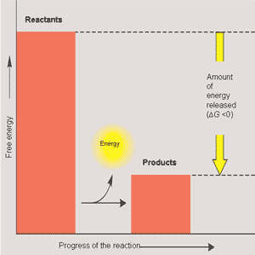
Exergonic
Releases energy
Products have less energy than reactants

Slide 5
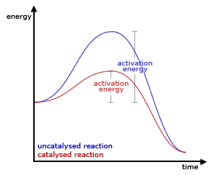
Catalyst – lower activation energy without adding heat
Catalysts control the speed of a reaction
Catalysts remain unchanged in the reaction and can be used over and over.

Slide 6
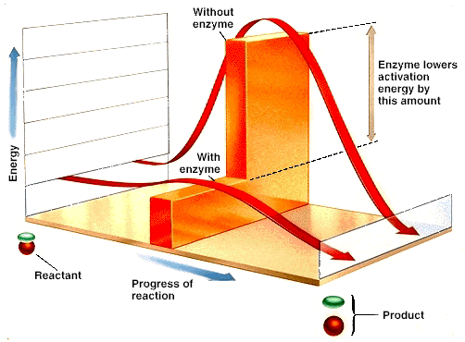
Activation Energy
Amount of energy required to start reaction
Keeps reactions from happening spontaneously
Enzymes lower activation energy without changing the product.

Slide 7
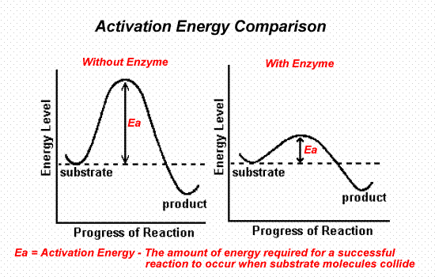
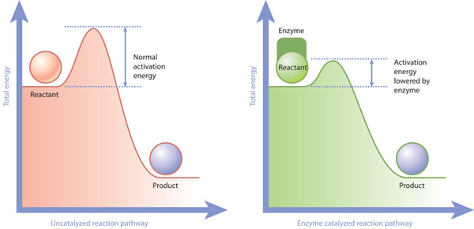

Slide 8
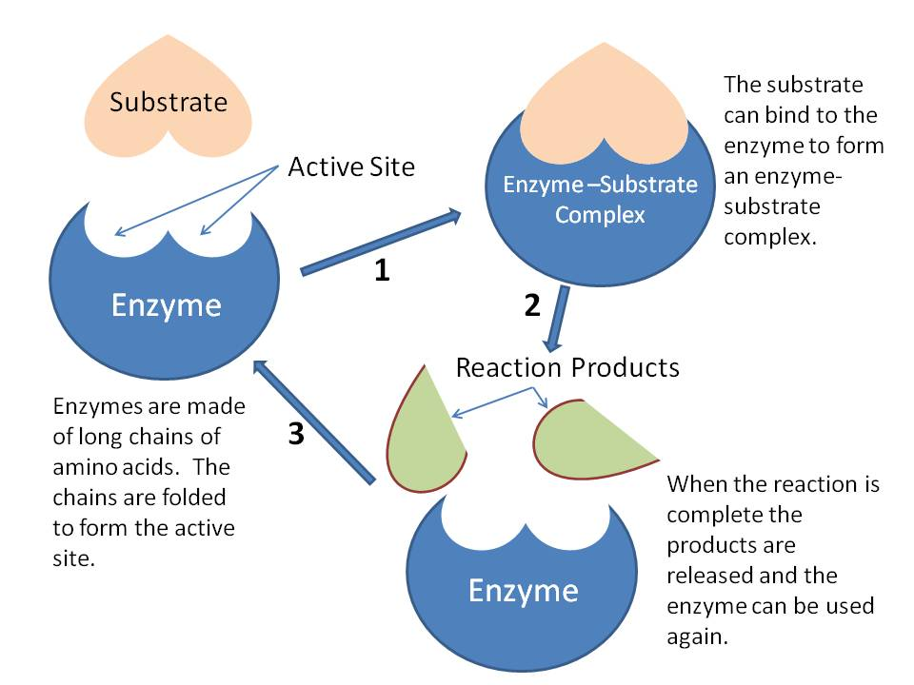
Enzymes are specific:
Substrate – enzyme’s target
Active site – where enzyme hooks up with substrate
Lock and key; induced fit
Products are released
Enzyme ready to go again

Slide 9
Cofactors – inorganic ions such as iron, zinc, potassium as well as copper containing compounds
Coenzymes – organic molecules that are synthesized from vitamins
Both help enzymes bind to substrate molecules.

Slide 10
Environmental effect on enzymes:
Denaturation – changes the shape
Can be caused by
Heat – cooking
pH too high or too low
Three factors that affect enzyme rates.
Temperature
pH
Concentration of substrate and enzymes
Competitive inhibitors
Student Activity

Slide 11
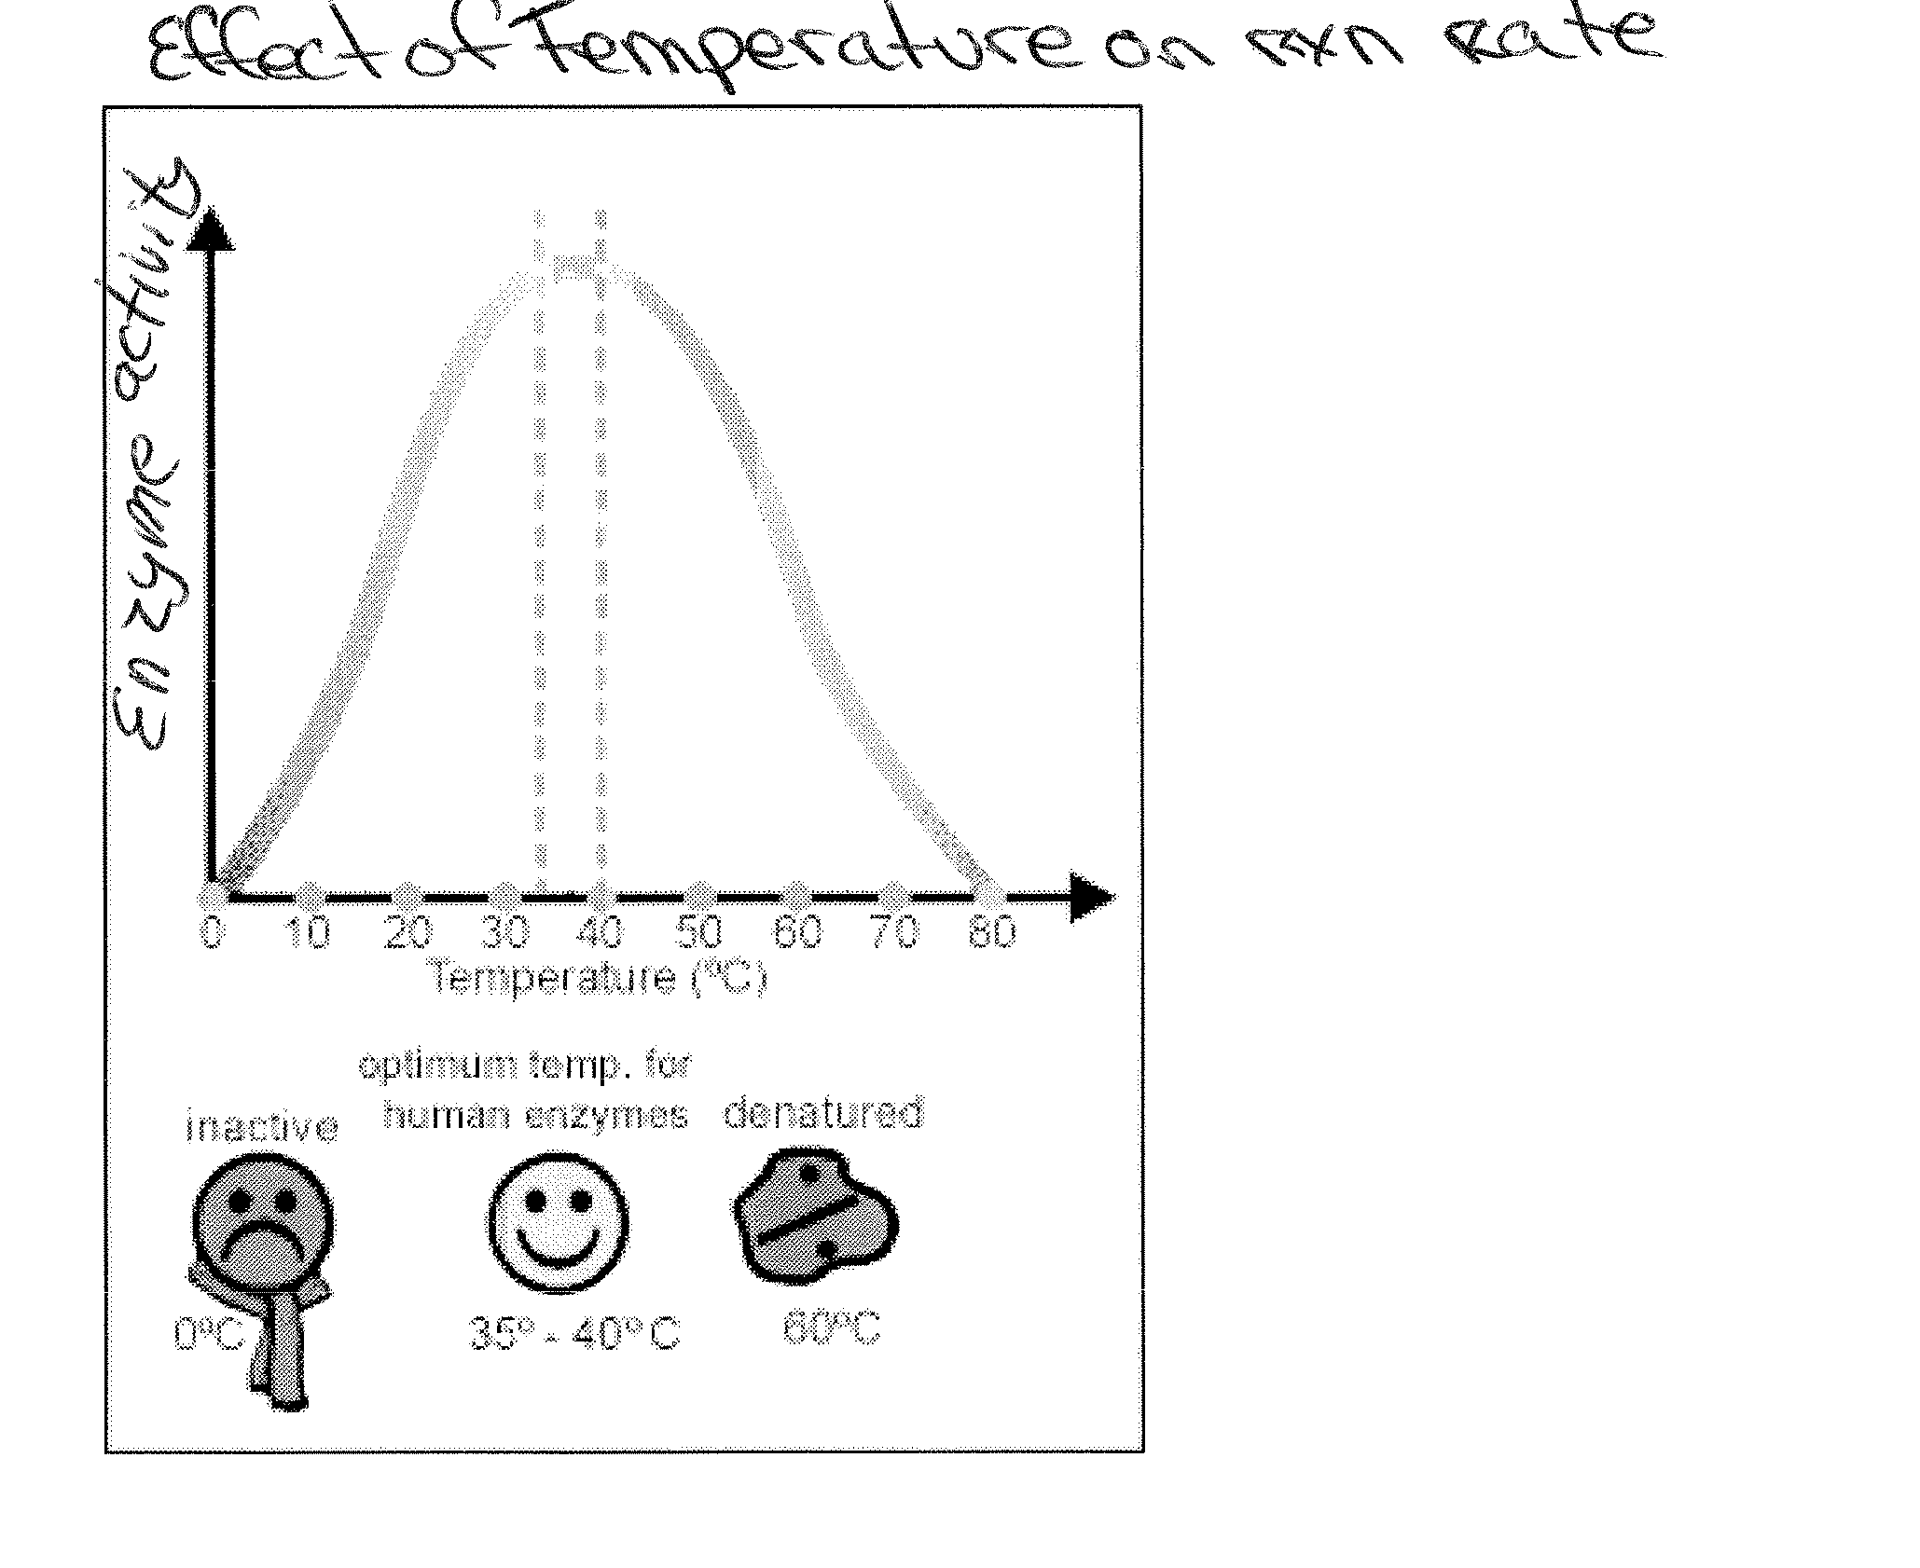
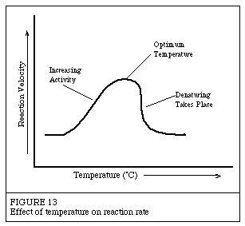
1. Temperature
Each enzyme works best at a specific temperature

Slide 12
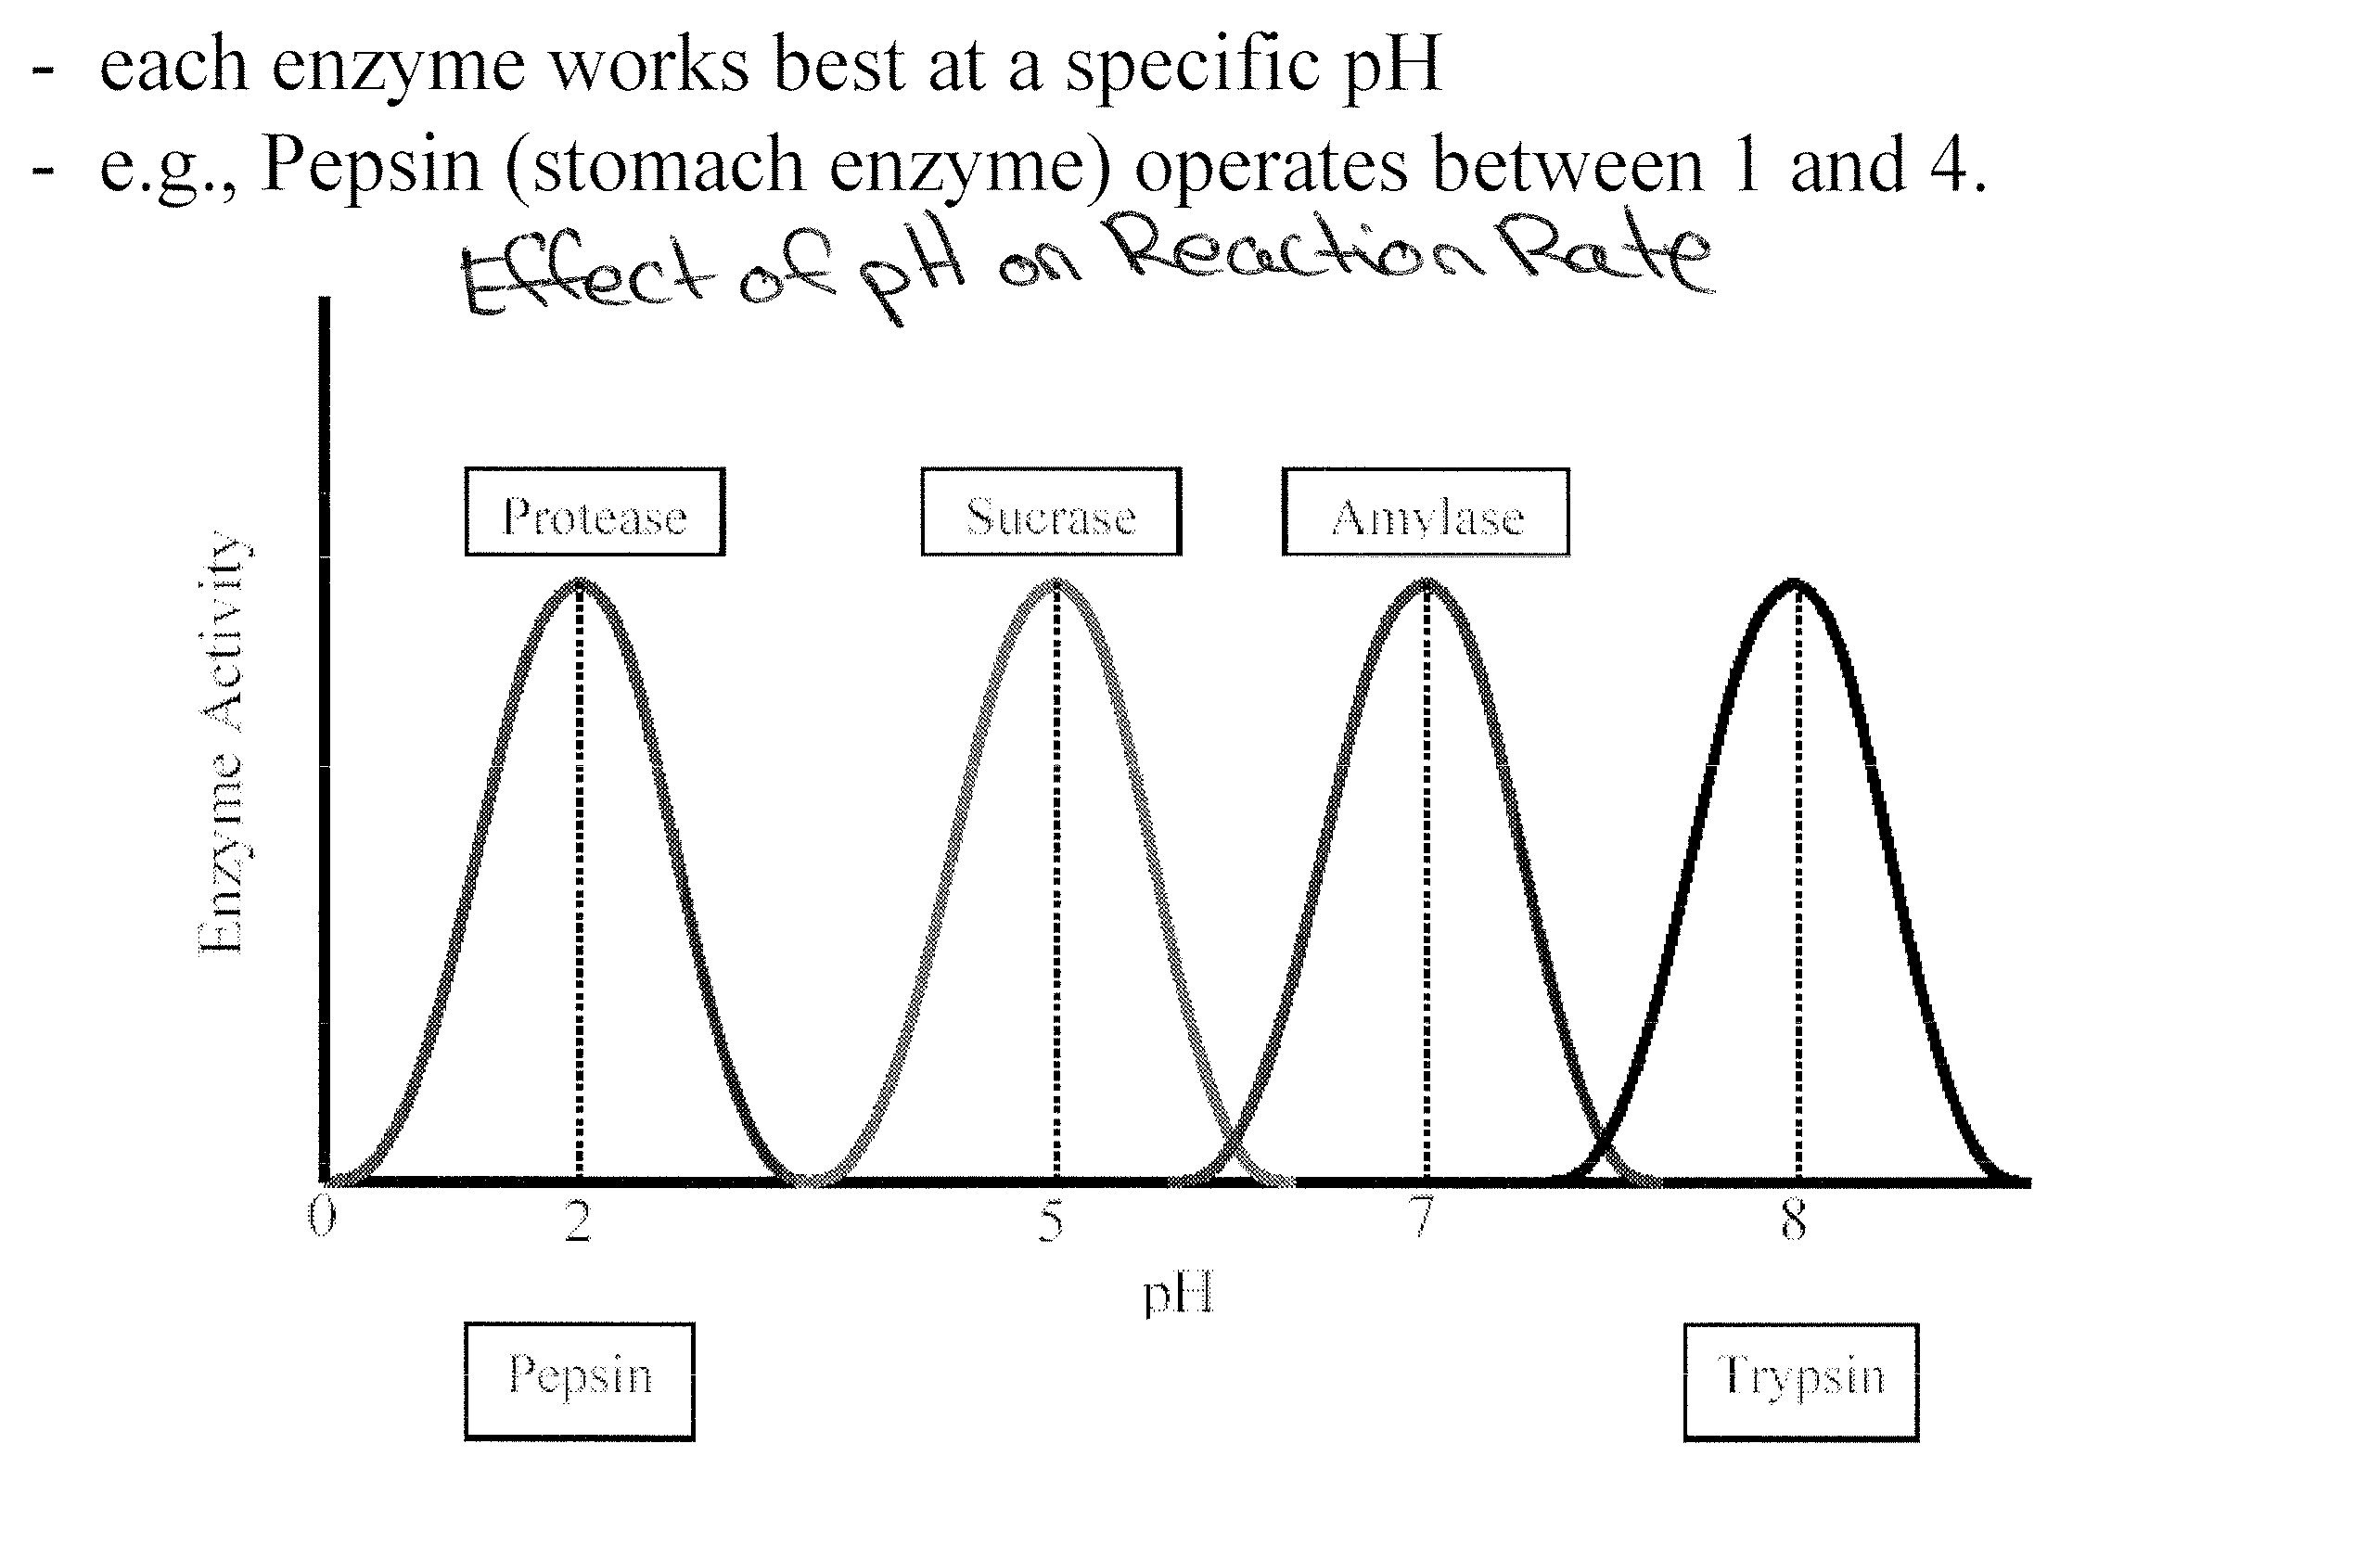
2. pH

Slide 13
3. Concentration of substrate and enzymes
i) for reactions involving no enzymes, the more substrate, the fast the reaction
ii) for reactions with enzymes, same as above but only up to a certain point. At a certain point the rate levels off due to the limit in the speed the enzyme can work.

Slide 14
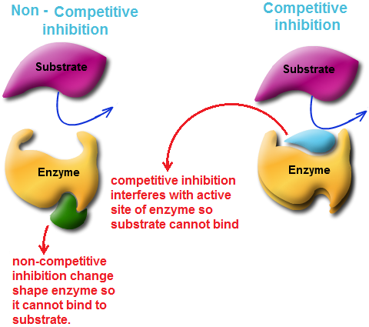
4. Competitive Inhibitors
Molecules that have similar shapes to substrate so they compete with the substrate for active sites on the enzymes

Slide 15
Regulation of Enzyme Activity
Feedback inhibition – the inhibition of an enzyme in a metabolic pathway by the final product of the pathway
the interference slows the reaction rate, preventing the accumulation of final products
Precursor activity – the activation of the last enzyme in a metabolic
pathway by the initial substrate
The fit of the substrate and enzyme combination is improved
therefore speeding up the formation of the final product.
Allosteric activity – a change in an enzyme caused by the binding
of a molecule
See Figure 8 on p 257 of your text.

Slide 16
Homework
Complete #1 – 13 on page 258
(Due tomorrow)

