Slide 1
Equilibrium Unbalanced

Slide 2
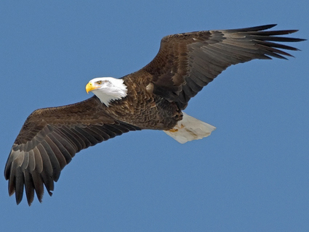
The bald eagle was once on the brink of extinction. These birds have made a triumphant comeback in the wild and are close to being taken off the list of threatened species.
In Canada, more than 450 species of plants and animals are at various degrees of risk, and 12 species have become extinct.
Refer to Figure 1 and 2 on page 11.

Slide 3
Extinct species are species that were formally indigenous to Canada that no longer exist anywhere. Example: Passenger Pigeon.
Extirpated species no longer exist in the wild in Canada, but they occur elsewhere. Example: Greater Prairie-Chicken
Endangered species are threatened with imminent extinction or extirpation throughout all or a significant portion of their Canadian range. Example: Peregrine Falcon
Threatened species are likely to become endangered in Canada if the factors affecting their vulnerability are not reversed. Example: Humpback whale
Vulnerable species are particularly at risk because of low or declining numbers, small range, or for some other reason, but are not threatened. Example: Grizzly
Special Concern refers to any species that is at risk because of low or declining numbers in some restricted area.

Slide 4
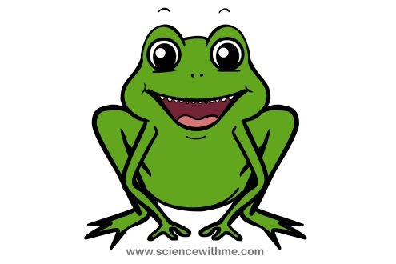
Indicatory Species
Species sensitive to small changes in environmental conditions.
Can be among the most sensitive species in a region, acting as an early warning to monitoring biologists.
Amphibians breathe partially through their skin, which is constantly exposed to the environment so their bodies are much more vulnerable and sensitive to factors such as disease, pollution, toxic chemicals, radiation, and habitat destruction. This makes them a good indicator species.

Slide 5
If something is wrong in the environment, say a pollutant, chances are that frogs will be among the first affected. When frogs in an area are often deformed or sickly, you can tell that there’s a problem in a nearby body of water.
What are the causes for amphibian decline?
Habitat destruction
Acid rain
Pollution (air and water quality)
Climate change
Over collection
Disease
UV radiation

Slide 6
Ultraviolet radiation – electromagnetic radiation from the Sun that can cause burning of the skin (sunburn) and cellular mutations.
Ozone (O3) – an inorganic molecule. A layer of ozone found in the stratosphere helps screen out UV radiation.
Recall: above the troposphere is the stratosphere, where air flow is mostly horizontal. The thin ozone layer in the upper stratosphere has a high concentration of ozone, a particularly reactive form of oxygen. This layer is primarily responsible for absorbing the UV from the sun.
Discuss 1-6 on page 16.

Slide 7
Detritus – waste from plants and animals, including their dead remains
Detritus food chains are critical in the recycling of matter in ecosystems. They include decomposers, organisms that break down detritus to get nutrients for their own use, but in the process also release nutrients to the soil and water. Plants and algae use those nutrients to grow.

Slide 8
Energy Flow in the Biosphere
Most of the energy that reaches the Earth’s atmosphere is filtered out before it reaches the surface. See fig. 1 on page 20.
30% reflected by clouds or Earth’s surface
44 % heats atmosphere and Earth’s surface
25 % heats and evaporates water
1% generates wind
0.023% used by plants for photosynthesis

Slide 9
Energy Transfer and Food Webs
Trophic Level of an organism is its position in a food chain, the sequence of consumption and energy transfer through the environment.
Green plants, algae and some types of bacteria form the first trophic level, the producers or autotrophs.
Herbivores form the second trophic level, while carnivores form the third and even the fourth trophic levels.

Slide 10
The source of all food is the activity of autotrophs, mainly photosynthesis by plants.
They are called producers because they can manufacture food from inorganic raw materials.
This food feeds herbivores, called primary consumers.
Carnivores that feed on herbivores are called secondary consumers.
Carnivores that feed on other carnivores are tertiary (or higher) consumers.
Heterotrophs cannot make their own food, and must obtain their food and energy from autotrophs or other heterotrophs.

Slide 11
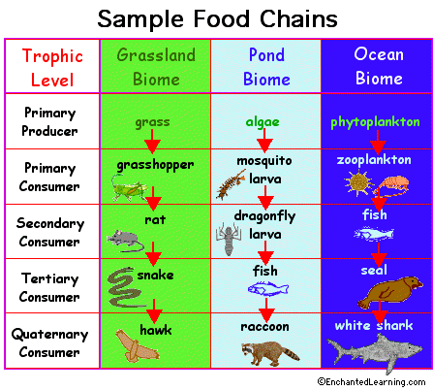
Energy and Food Chains
Food chain – the feeding of one organism upon another in a sequence of food transfers or, the transfer of energy (which typically comes from the sun) from one organism to another.
Note: Except in deep-sea hydrothermal ecosystems, all food chains start with photosynthesis and will end with decay.
Grass -> grasshopper -> toad -> snake -> hawk -> bacteria of decay
Autotrophs Herbivores carnivores decomposers
Producers Primary consumers secondary, tertiary, etc consumers
Food webs – describe the feeding relationships among organisms in an ecosystem.

Slide 12
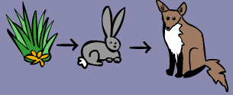
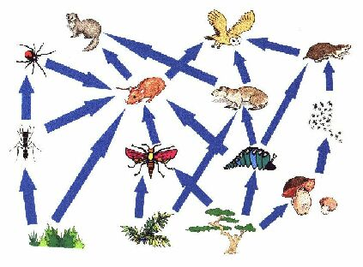

Slide 13
Ecosystems with greatest biodiversity, have well-developed food webs, and removal of one type of organism may have only a small effect on the overall web.
Ecosystems with lower biodiversity have simpler food web, and the more vulnerable each organism is to changes in the ecosystem. The limited number of organisms means that their relationships with each other are more direct.

Slide 14
Photosynthesis and Respiration
CO2 + H2O + energy → C6H12O6 + O2
C6H12O6 + O2 → CO2 + H2O + energy
Note:
The processes of photosynthesis and cellular respiration are complementary.
Therefore a balance of oxygen and carbon dioxide is maintained within any ecosystem.
Plants produce about nine times the amount of oxygen by photosynthesis than they use up in cellular respiration.

Slide 15
Chemosynthesis
A process in which carbohydrates are manufactured from carbon dioxide and water using chemical nutrients as the energy source, rather than the sunlight used for energy in photosynthesis.
These bacteria, referred to as chemoautotrophs are fueled by the oxidation of simple inorganic chemicals, such as hydrogen sulfide, ammonia, ferrous ions, or sulfur.
Chemosynthetic autotrophs are a necessary part of the nitrogen cycle.
The organisms that use chemosynthesis thrive in very hot (350 C) water around hydrothermal vents on the ocean floor.

Slide 16
Limits on Energy Transfer
At each trophic level along a food chain, there is always a ‘loss’ of matter and energy.
Energy is transferred to a different form:
Some of the energy is released as thermal energy during cellular respiration
Some is converted to other chemical energy in molecules other than glucose
Some is lost in the form of waste energy (CO2, feces)
Some is converted to kinetic energy
Up to 90% of matter and energy can be ‘lost’ at each level.

Slide 17
Laws of Thermodynamics
Thermodynamics is the study of energy transformations.
First Law of thermodynamics states that energy can be transformed from one form to another, but it cannot be created or destroyed.
Second Law of Thermodynamics states that during any energy transformation, some of the energy is converted into an unusable form, mostly thermal energy, which cannot be passed on.

Slide 18
P 27 1-8

