Slide 1
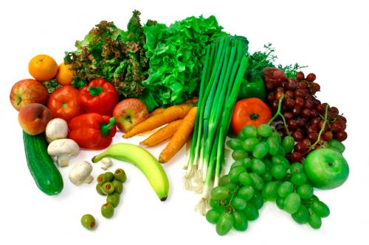
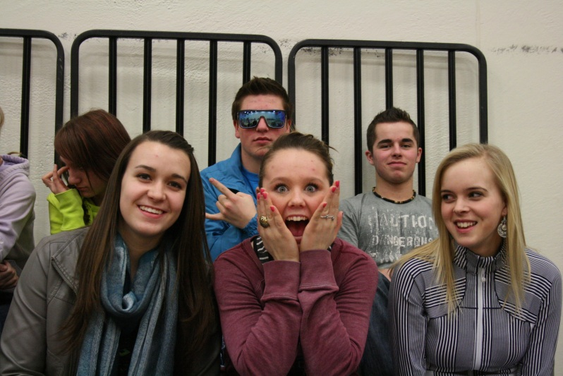
Cellular Respiration
H2O
Glucose/Food
CO2
Oxygen
ENERGY
http://youtu.be/CrrXD9hiQ0c

Slide 2
Cellular Respiration (general formula)
C6H12O6 + 6O2 6CO2 + 6H2O + energy (36 ATP)
What is the primary function of cellular respiration?
A process in cells in which there is a release of energy from the stored bonds of
glucose molecules. This energy is stored in a more directly usable form; ATP.

Slide 3
In cellular Respiration, the intermediate products include NADH, FADH2 and ATP.
NADH is the reduced form of NAD+. NADH is an electron carrier;
donates electrons in cellular processes.
FADH2 is the reduced form of FAD+ (flavin adenine dinucleotide).
FADH2 is an electron carrier, donates electrons in cellular processes.
FAD+ an electron carrier accepts elecgtrons in cellular processes.
Electron carriers – their role is to transfer electrons through oxidation-reduction
reactions.
The transfer of electrons releases energy that can be used in cellular respiration.
The energy from an oxidation-reduction reaction is used to attach phosphates to
ADP to make ATP.
ATP is a high-energy compound.

Slide 4
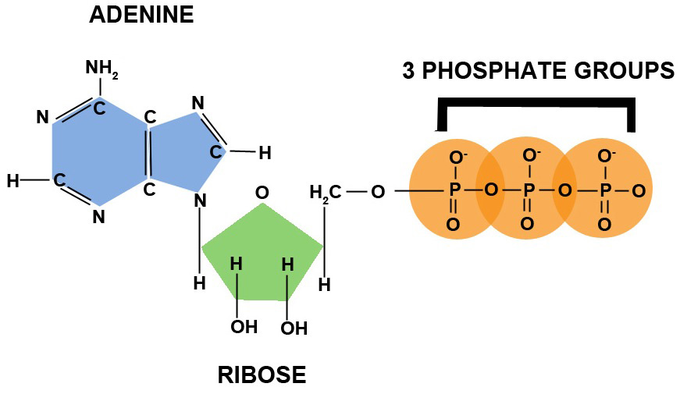
Metabolic processes that use ATP as an energy source convert it back into its precursors.
ATP is therefore continuously recycled in organisms
Gold coin analogy.
Oxidation-Reduction Reaction
Oxidation - involves the loss of electrons or hydrogen OR gain of oxygen OR increase in oxidation state
Reduction - involves the gain of electrons or hydrogen OR loss of oxygen OR decrease in oxidation state
The energy released from the redox reaction
Is used to attach a free phosphate to ADP to
Make ATP. ATP is a high energy compound.
The redox reaction could be the transfer of
Electrons from high-energy compounds such
As when NADH is oxidized to form NAD+ and H+.

Slide 5
How do the oxidation and reduction reactions in electron transfer help to form ATP?
Each time electrons are transferred in oxidation-reduction reactions, energy is made
available for the cell to make ATP. Electron transport chains shuttle electrons from
one molecule to another. For example, the oxidizing agent NAD+, along with H+ remove
high-energy electrons from organic molecules and form NADH. It then transfers these
electrons to energy releasing chemical pathways. The energy released in these pathways
Is transferred to ADP and P to form ATP.

Slide 6
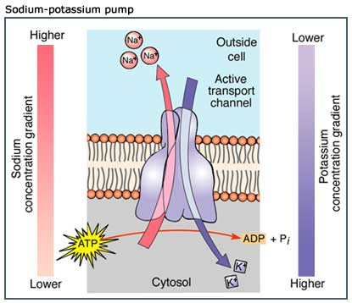
Why do we need ATP?
Active transport is the movement of substances through a membrane against
a concentration gradient using a membrane-bound carrier proteins and energy from
ATP.
Carrier proteins are often referred to as “pumps” .
Potassium and sodium ions are moved into and out of cells by a pump known as
sodium-potassium pump.
The energy is used to actively transport
three sodium ions out of a cell for every
two potassium ions that are transported
into a cell.
Without this pump, nerve cells and
muscle cells could not function properly.
Vitamins, amino acids, and hydrogen ions
are also actively transported across the
membranes.

Slide 7
A glucose molecule contains approximately 100 times as much energy as an ATP
molecule, but this energy cannot be used directly by the cell.
Glucose is a simple sugar or a monosaccharide.
It is in our “blood sugar”.
It has a high-energy content and is relatively small and highly soluble.
These properties make glucose ideal for transportation within and between
Cells, and throughout the body.

Slide 8
It always takes energy to break chemical bonds, and energy is always released
when new bonds form.
The energy released by cellular respiration is used to synthesize ATP molecules
To be used as the energy currency within the cell.
The process of cellular respiration is not 100% efficient. Only 36% of the energy
content of a single glucose molecule is converted into the energy of ATP.
The remaining 64% is released as heat. The thermal energy is not waste for all
Organisms. It is used by groups of organisms to maintain a constant body temperature.
Eg., birds and mammals

Slide 9
TWO types of CELLULAR RESPIRATION
1. Aerobic Cellular Respiration
Reactions that takes place in the cell in the presence of oxygen and releases
energy stored in glucose.
The end products of aerobic cellular respiration are carbon dioxide gas, water,
and 36 ATP molecules.
Aerobic cellular respiration involves four stages.
Glycosysis
Pyruvate oxidation
The krebs cycle
The electron transport chain and chemiosmosis

Slide 10
2. Anaerobic Cellular Respiration
Takes place in the absence of oxygen, and glucose is not completely oxidized.
Involves two steps:
Glycolysis
fermentation
Two types of anaerobic cellular respiration that occur in eukaryotes:
Note:
The first stage for both aerobic and anaerobic respiration is glycolysis and occurs in
the cytoplasm of the cell.
Also, aerobic respiration produces many more ATP molecules than do anaerobic.

Slide 11
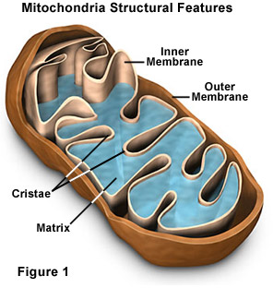
Aerobic Cellular Respiration
Aerobic cellular respiration has four stages: These are:
1. Glycolysis
Takes place in the cytoplasm.
2. Pyruvate oxidation
Takes place in the matrix.
3. Krebs cycle
Takes place in the matrix.
4. Electron transport chain and chemiosmosis
Takes place in the inner membrane.
Mitochondrion is a eukaryotic cell organelle in which
aerobic cellular respiration occur
Usually they are rod-shaped, however they can be round.
Mitochondrion is bounded by a double membrane
An outer membrane that encloses the entire
structures and is fairly smooth.
An inner membrane is highly convoluted, forming
folds called cristae. The cristae greatly increase the
inner membrane’s surface area. It is on these cristae
that food (sugar) is combined with oxygen to produce
ATP – the primary energy source for the cell.

Slide 12
The double membranes divide the mitochondrion into two distinct parts:
The intermembrane space, and
The mitochondrial matrix
Intermembrane space – is the fluid-filled space between the inner and outer
mitochondrial membranes.
Mitochondrial matrix – is a protein-rich liquid that fills the interior space of the
Mitochondrion.
Mitochondria also have their own DNA and ribosomes.

Slide 13
Cellular Respiration
Reactions occur in the mitochondrion which release chemical energy from food materials.
Cellular respiration can be either:
Aerobic – involving oxygen, or
Anaerobic – taking place in the absence of oxygen.
Fermentation – the respiration of glucose under anaerobic conditions.
Aerobic respiration frees far more energy per molecule of glucose then anaerobic does.

Slide 14
The overall process of respiration can be conveniently divided into four stages.
Glycolysis, is an anaerobic stage where the glucose molecule is partially broken down and rearranged producing a three-carbon compound called pyruvic acid.
Pyruvate oxidation (Transition), the product of glycolysis is brought into the matrix to continue the krebs cycle.
Krebs Cycle, an aerobic stage where the chemicals present undergo further breakdown, resulting also in the release of reduced energy carriers and CO2(g).
Oxidative Phosphorylation (Electron Transport Chain), a second aerobic stage where oxygen combines with the reduced carriers resulting in the formation of ATP and water.

Slide 15
Glycolysis
Process in which ATP is formed by the conversion of glucose into pyruvic acid.
Means “splitting of sugar”.
Occurs outside of mitochondria, in the cytoplasm of the cell.
Process proceeds where no oxygen is available (in both aerobic and anaerobic cellular respiration).

Slide 16
The main raw material (substrate) is glucose.
Glucose may be obtained from:
Plants as starch.
Animals as glycogen.
Proteins and fatty acids may also be broken down to provide energy.
Glucose is a rather stable molecule and activation energy (ATP) is
Needed in order to begin breaking it down.
- a glucose molecule is phosphorylated by ATP
- six carbon sugar is broken down into two molecules of
three-carbon pyruvic acid.
For each molecule of glucose which enters glycolysis, four ATP
molecules are generated.
Two phases of Glycolysis:
Energy investment phase.
Energy-yielding phase.

Slide 17
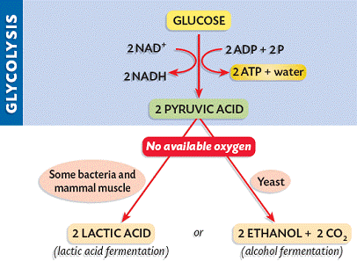
Anaerobic Respiration
Steps:
Glycolysis
Occurs in cytoplasm of cell.
Inefficient because it uses 2 ATP molecules but gives off 4 ATP therefore, has a net gain of 2 ATP.
Because no O2 present, krebs cycle and ETC don’t work.

Slide 18
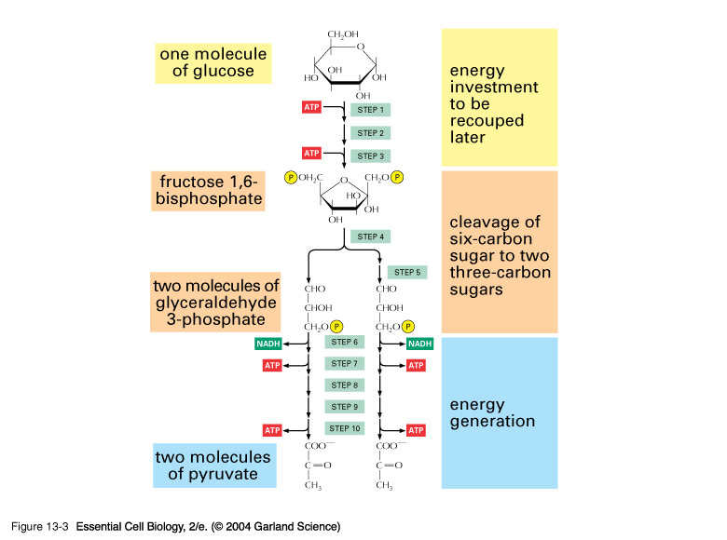
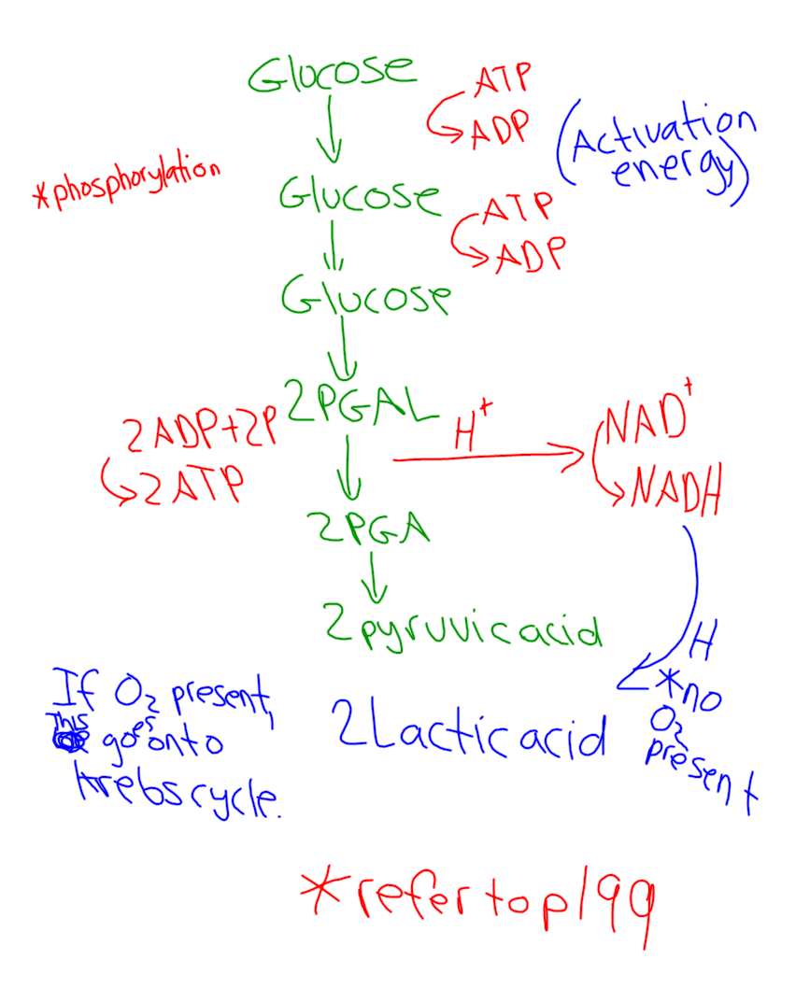
Aerobic Respiration

Slide 19
It is important to note:
For every glucose molecule that enters glycolysis
- 2 ATP are used as activation energy
- 4 ATP are produced (Net gain of 2 ATP)
- 2 NAD oxidize PGAL (release energy for ATP)
NADH will be used later in the E.T.C if O2 is present
- results in 2 pyruvic acid if O2 is present
results in lactic acid if not O2 is present

Slide 20
Pyruvate Oxidation (Transition/Pre-Krebs)
Glycolysis releases less than a quarter of the chemical energy stored in glucose; most of the energy remains stocked in the two molecules of pyruvate.
If oxygen is present, the pyruvate enters the mitochondrion, where the enzymes of krebs cycle complete the oxidation of the organic fuel.
Pyruvic acid is oxidized
The 2 pyruvic molecules break down to acetic acid and CO2.
Coenzme A, (a non-protein molecule that must be present for certain enzymes to function), attaches to the acetic acid, making a compound called acetyl-CoA.
Acetyl CoA is now ready to feed its acetate into the krebs for further oxidation.

Slide 21
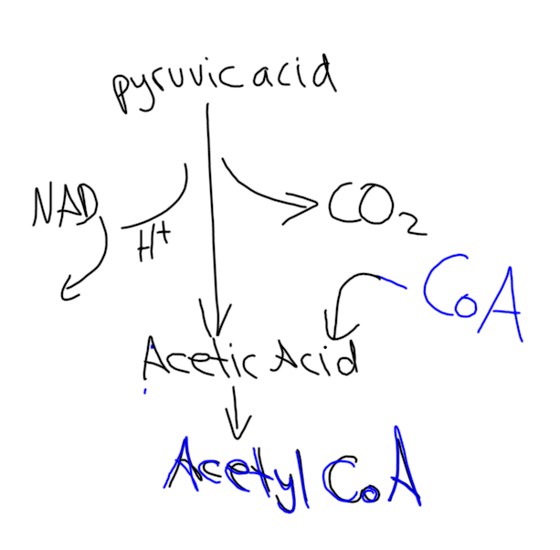

Slide 22
It is important to note, in the process:
1 NADH and 1 CO2 are made by each pyruvic acid.
(Therefore, 2 NADH and 2 CO2)
NADH is used later in the E.T.C.
CO2 is breathed out.

Slide 23
Krebs Cycle (Citric Acid Cycle)
Occurs in the matrix of the mitochondrion.
It takes each of the acetyl CoA molecules from transition and carries each through a complete cycle.

Slide 24
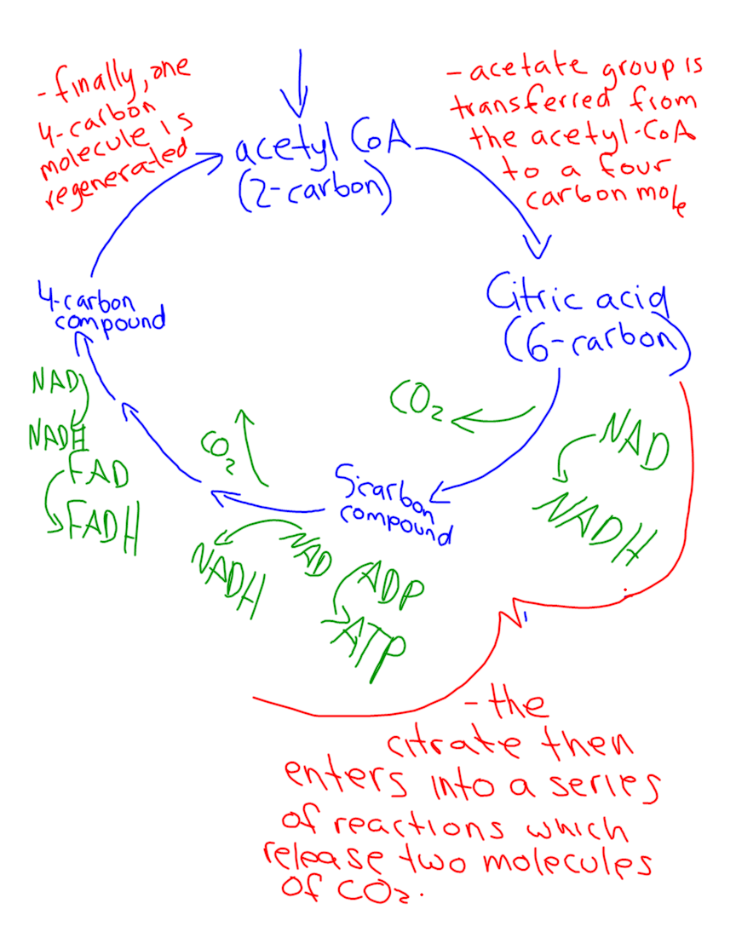
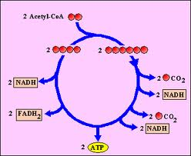

Slide 25
It is important to note:
for every acetyl CoA molecule that enter the Kreb cycle:
2 CO2 are produced (4 per glucose)
3 NADH are produced (6 per glucose)
1 FADH is produced (2 per glucose)
1 ATP is produced (2 per glucose)
Electron acceptors
donate electrons to
the E.T.C.

Slide 26
With the completion of glycolysis and the krebs cycle, the glucose is broken down into six molecules of CO2.
95% of the energy of the glucose molecule is conserved as reduced electron carriers (NADH and FADH) and a small amount of ATP.
Electrons take their electrons to the E.T.C where ATP is produced.

Slide 27
Electron Transport and Chemiosmosis
NADH give up two high-energy electrons at the beginning of the E.T.C.
At the same time, it releases H+ ion into the matrix.
The electrons are then passed from carrier molecule to carrier molecule in the inner membrane of the mitochondrion, losing some of their energy at each step.
The energy that is released in these steps is enough to power a process that drives ADP and phosphate molecules together to produce ATP. This process is called Chemiosmosis.
Oxygen is a great electron acceptor and so the electrons are combined with hydrogen ions and oxygen to make water. This prevents electrons from building up in the election transport system.

Slide 28
