Slide 1
Breathing Movements
Pressure differences between the atmosphere and chest cavity determine the movement of gases into and out of the lung.
Gases move from an area of high pressure to an area of low pressure.
Diaphragm – is a sheet of muscle that separates the organs of the chest cavity from those of the abdominal cavity
Notes:
Breathing Movements

Slide 2
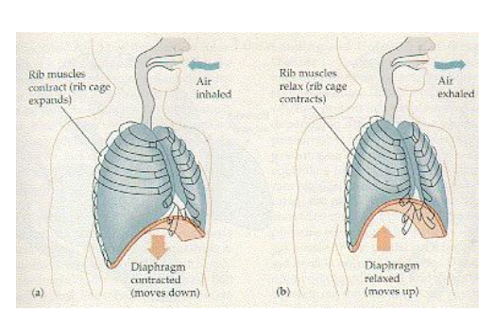
Inspiration – inhaling -> pleural pressure < atmosphere pressure
Expiration – exhaling -> pleural pressure > atmosphere

Slide 3
Diaphragm is assisted by the movement of the ribs.
External intercostal muscles (found between ribs)
Contract and pull upward and outward increasing the volume of the chest and lowering pressure
The muscles relax and the rib cage falls
Internal intercostal muscles – pull ribcage downward during times of extreme exercise increasing pressure (not employed during normal breathing)

