Slide 1
Gas Exchange

Slide 2
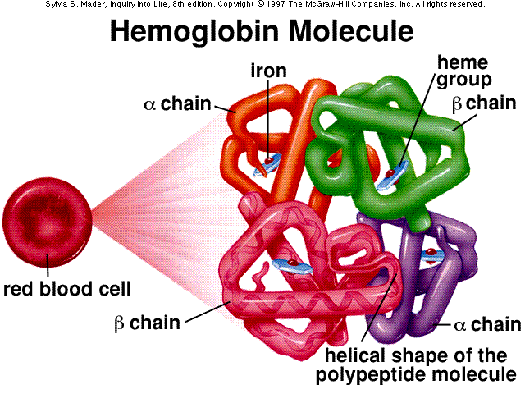

Slide 3
Overview
Inhaled O₂ moves from an area of high concentration (alveoli) to an area to low concentration (lung capillaries).
CO₂ follows the reverse path.
Blood has hemoglobin (Hb) that carries 4 O₂ molecules at a time.
Cell respiration uses O₂ and makes CO₂.
CO₂ and water is changed by enzymes into carbonic acid which dissociates into bicarbonate ions.

Slide 4
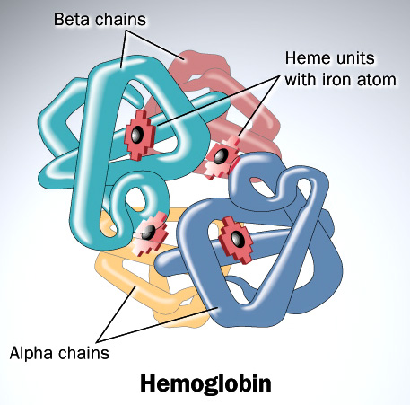

Slide 5
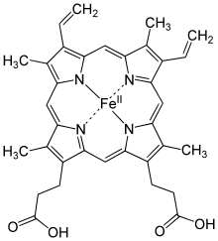
The heme group

Slide 6
Diffusion
Gases diffuse from an area of higher pressure to an area of lower pressure.
Partial pressure: Each gas in a mixture adds a portion of pressure to the total pressure.
Gas pressure is measured in kilopascals (kPa) or millimetres of Mercury (mm Hg)
http://phet.colorado.edu/en/simulation/gas-properties

Slide 7
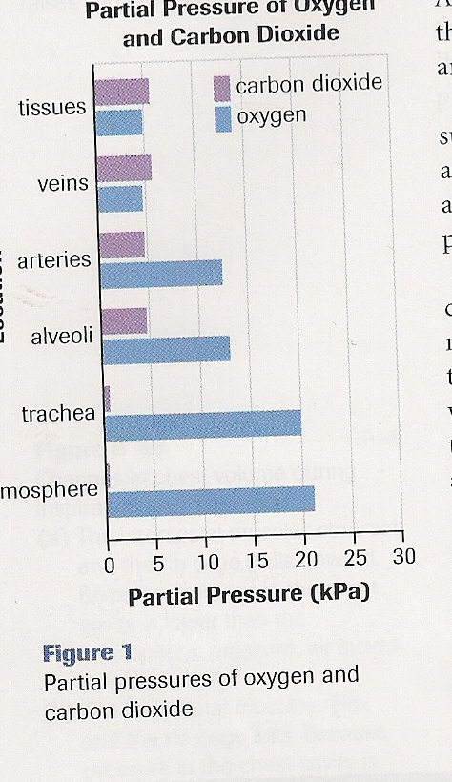
The partial pressure of oxygen ( pO₂ ) differs depending on the body location.
The highest pO₂ is in the trachea and alveoli.
Lowest pO₂ is at the cell level, the capillaries.

Slide 8
Hemoglobin
Hemoglobin (Hb) is made of proteins and an Iron group, the heme group.
Hb binds with O₂ and forms oxyhemoglobin (HbO₂)
Role #1 is to transport O2 from lungs to every cell.
100mL of blood can carry 20ml of O₂
→most of the O₂ is with HbO₂ , only very little gas is dissolved in the plasma.

Slide 9
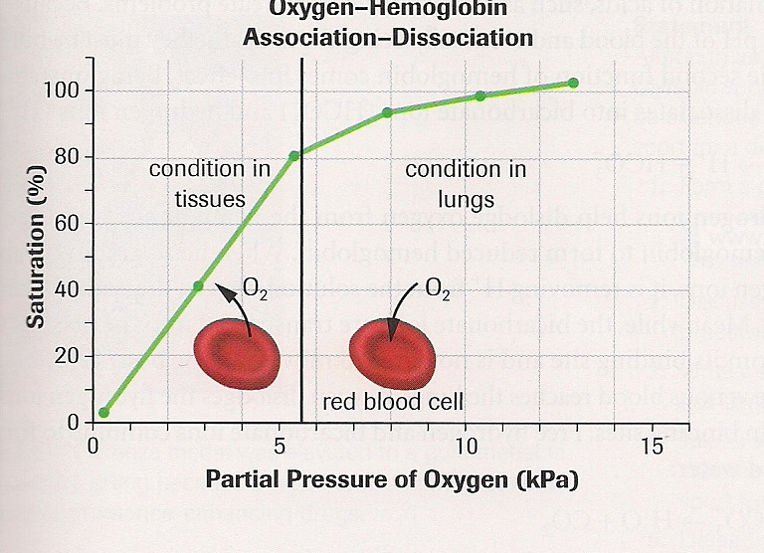
At higher pressure, Hb will combine with O₂
[ This happens in the lungs]
At lower pressure, Hemoglobin will release O_{2.}
[This happens in the muscle tissue]

Slide 10
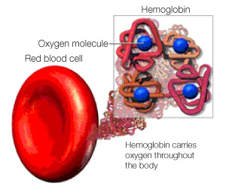

Slide 12
CO₂ can be transported 3 ways
1) CO₂ gas dissolves in plasma
2) CO₂ gas binds to Hb to form carbaminohemoglobin
3) CO₂ is reacted with H₂O to form carbonic acid then into bicarbonate ions
Reaction: CO₂ + H₂O → H₂CO₃ → H⁺ + HCO₃⁻

Slide 14
Carbonic anhydrase is the fastest known enzyme.
The H+ ions help the Hb ions release the O2.
Role #2 for Hb: Hb acts as a buffer. The Hb grabs the H+, removing acid from the blood.

Slide 15
Applications
Medicine – anemia, first aid CPR, CO poisoning, http://www.masimo.com/hemoglobin/anemia.htm
Sports -blood doping, blood steroids, high altitude Olympic training facilities
Recreation -SCUBA diving, travel, Mt. Everest mountain “death zone” www.altitude.org

Slide 18
There are lots of RBCs in your body 20-30 trillion
Each RBC has 270 million hemoglobin molecules

Slide 19
Take home message
Know the role carbonic anhydrase
Different partial pressures helps O₂ diffuse into/out of RBC.
Can you explain where Hb takes up then releases O₂ . Can you explain where Hb takes up then releases CO₂
CO₂ movement occurs because of diffusion. CO₂ is transported in 3 forms.
What are the 2 roles of Hb.

