Slide 1
Biogeochemical Cycles
All matter cycles … it is neither created nor destroyed ….
As the Earth is essentially a closed system with respect to matter, we can say that all matter on Earth cycles.
Biogeochemical cycles: the movement (or cycling) of matter through a system.
by matter we mean: elements; carbon, nitrogen, oxygen or molecules (water)

Slide 2
We can subdivide the Earth system into:
Atmosphere
Hydrosphere
Lithosphere
Biosphere
The movement of matter (example carbon) between these parts of the system is a biogeochemical cycle.
Macronutrients: required in relatively large amounts
Carbon
Hydrogen
oxygen
Nitrogen
Phosphorous
Sulfur
Potassium
Calcium
Iron
magnesium

Slide 3
Micronutrients: required in very small amounts, (but still necessary)
boron (green plants)
copper (some enzymes)
molybdenum (nitrogen-fixing bacteria)
Biogeochemical cycles are part of the larger cycles that describe the functioning of the whole Earth.

Slide 4
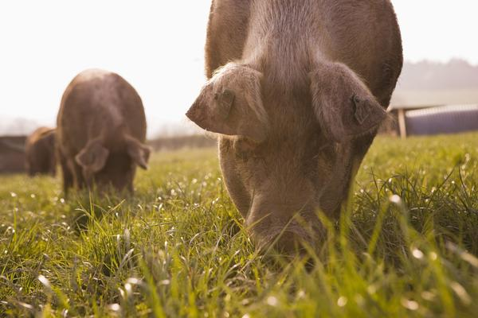
The Carbon Cycle and the Oxygen Cycle
Carbon (C) is the basis of life on Earth.
Scientists consider 99.9% of all organisms on the planet to be carbon based life. Those organisms need carbon to survive.
Whether the carbon is in the form of a sugar or carbon dioxide gas, we all need it.
Unlike energy, carbon is continuously cycled and reused. The Earth only has a fixed amount of carbon. The carbon cycle is the ultimate form of recycling.
Plants pull carbon from the air
and animals eat the plants.

Slide 5
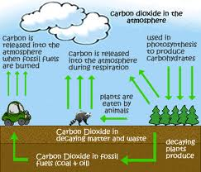
Carbon Cycle

Slide 6
Organic matter (or organic material) is matter that has come from a recently living organism; is capable of decay.
The concentration of carbon in living matter (18%) is almost 100 times greater than its concentration in the earth (0.19%). So living things extract carbon from their nonliving environment. For life to continue, this carbon must be recycled.
Carbon exists in the nonliving environment as:
Carbon dioxide (CO2) in the atmosphere and dissolved in water (forming HCO3)
Carbonate rocks (limestone and coral = CaCO3)
Deposits of coal, petroleum, and natural gas derived from once-living things
Dead organic matter, e.g., humus in the soil

Slide 7
Carbon returns to the atmosphere and water by
Respiration (as CO2)
Burning
Decay (producing CO2 if oxygen is present, methane (CH4) if it is not.
Combustion occurs when any organic material is reacted (burned) in the presence of oxygen to give off the products of carbon dioxide and water and ENERGY. The organic material can be any fossil fuel such as natural gas (methane), oil, or coal. Other organic materials that combust are wood, paper, plastics, and cloth. Organic materials contain at least carbon and hydrogen and may include oxygen. If other elements are present they also ultimately combine with oxygen to form a variety of pollutant molecules such as sulfur oxides and nitrogen oxides.

Slide 8
Reservoirs for Inorganic Carbon
When it is not in organic form, carbon can be found in there main reservoirs: the atmosphere, the oceans, and Earth’s crust.
The smallest of these reservoirs is the atmosphere.
CO2 makes up about 0.03% of the gases we breathe in.
Carbon dioxide enters the waters of the ocean by simple diffusion.
Once dissolved in seawater, the carbon dioxide can remain as is or can be converted into carbonate (CO3)or bicarbonate (HCO3)
Certain forms of sea life biologically fix bicarbonate with calcium (Ca) to produce calcium carbonate (CaCO3). This substance is used to produce shells and other body parts by organisms such as coral, clams, oysters, some protozoa, and some algae.
When these organisms die, their shells and body parts sink to the ocean floor where they accumulate as carbonate-rich deposits. After long periods of time, these deposits are physically and chemically altered into sedimentary rocks. Ocean deposits are by far the biggest sink of carbon on the planet.
Volcanic activity and Acid rain falling can break down the calcium carbonate rocks (limestone), releasing carbon dioxide into the atmosphere.

Slide 9
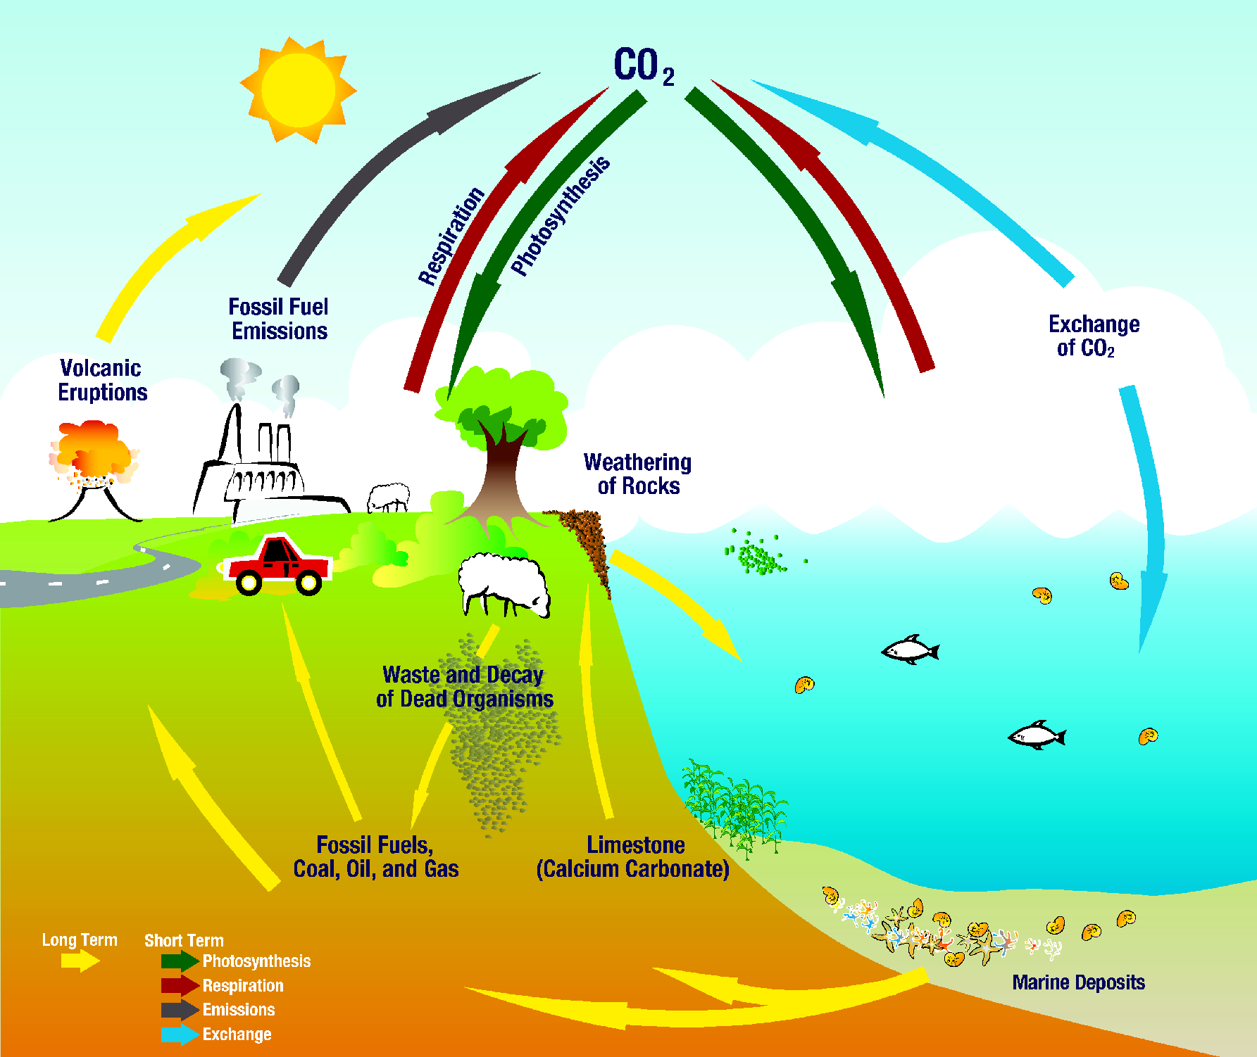

Slide 10
Reservoirs for Organic Carbon
Organic carbon is also held in reservoirs – the bodies of living things.
All living things die, and decomposition returns the carbon to the cycle in inorganic form.
Exception: Some ecosystems, such as bogs, store huge quantities of carbon in organic form.
A bog is a type of wetland that accumulates acidic peat, a deposit of dead plant material – usually mosses.
Bogs contain very little oxygen, and under these conditions decomposition is very slow.
Bogs have been recognized for their role in regulating the global climate by storing large amounts of carbon in peat deposits.
Bogs are unique communities that can be destroyed in a matter of days, but require hundreds, if not thousands, of years to form naturally.
Carbon atoms may remain locked away in dead plant matter (peat) for many years in a bog.
These deposits are covered by sediment.
The slowly decaying organic matter are trapped between layers of rock, resulting in the formation of carbon-containing fossil fuel, coal. (fig. 3, page 50)
Oil is formed in a process similar to the formation of coal, when decaying aquatic animals and plants are trapped under sediment in a low-oxygen environment.

Slide 11
Carbon fixation – is a process whereby a producer/autotroph takes carbon dioxide from the atmosphere and uses it to build an organic compound. (photosynthesis)
Carbon sink – when there is a large quantity of solid carbon compounds that are physically cut off from the atmosphere or have ceased to cycle through the biosphere. E.g., swamps, bogs, and deep ocean floors that are compressed and driven deep into Earth by volcanic forces over thousands of years are transformed into coal, graphite and natural gas.
an important factor in the carbon cycle is the function of decomposers.
Two types of decomposers:
Aerobic decompostion – requires oxygen and produces CO2
Anaeorobic decomposition – does not require oxygen and produces methane (CH4)

Slide 12
Human Impact on the Carbon Cycle
Humans have increased the amount of carbon dioxide into the atmosphere by clearing away vegetation in order to build farm.
Destruction of vegetation reduces the amount of photosynthesis, and so reduces the amount of carbon dioxide removed from the atmosphere.
The Greenhouse Effect
The shorter wavelengths of sunlight (primarily infrared) enter the atmosphere.
These are absorbed and re-radiated as longer wavelengths.
The reflected light is prevented from escaping by the atmosphere. The Earth heats up. (See fig. 5, page 52)
The greenhouse gases (CO2, CH4) trap the heat from the sun and warm the Earth’s surface.
A certain amount of “greenhouse gas” is essential for the survival of life on Earth.
Without greenhouse gases, the average temperature of the planet would fall from 15C to -18C.

Slide 13
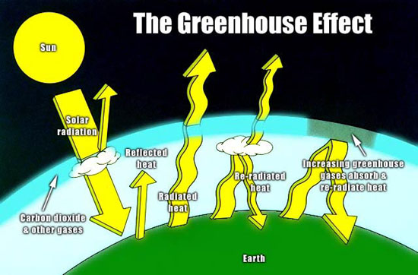
Global warming is the increase in the average measured temperature of
the Earth’s atmosphere.
Human activity has been increasing the concentration of greenhouse gases
in the atmosphere through fossil fuel combustion and deforestation.
(see figure 7, page 53)

Slide 14
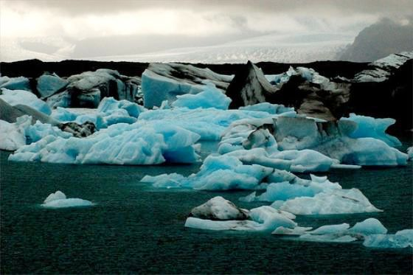
Effects of a Warmer Climate
Layer of ground that remains permanently frozen would thaw, causing the collapse of roads and buildings that rely on frozen ground for support.
Snowcaps would melt and rivers would overflow, causing flooding in many of our cities.
Melting snow and glaciers would also raise the level of the world’s oceans, causing drastic changes in coastal areas.
Flooding could become worse, causing enormous property damage.

Slide 15
Albedo Effect
Albedo is a term used to describe the extent to which a surface can reflect radiation.
The higher the albedo of the surface, the less energy will be absorbed.
An albedo of 0.08 means that 8% of the light is reflected.
The albedo of snow and ice cover is extremely high. During winter, the Sun’s energy reflects off snow, keeping temperatures low.
Snow is part of a cycle known as snow-temperature feedback. (figure 9, page 54)
If the area warms up, the snow will melt. Less of the sun’s radiation will be reflected, so more radiation will be absorbed. The temperature will increase.

Slide 16
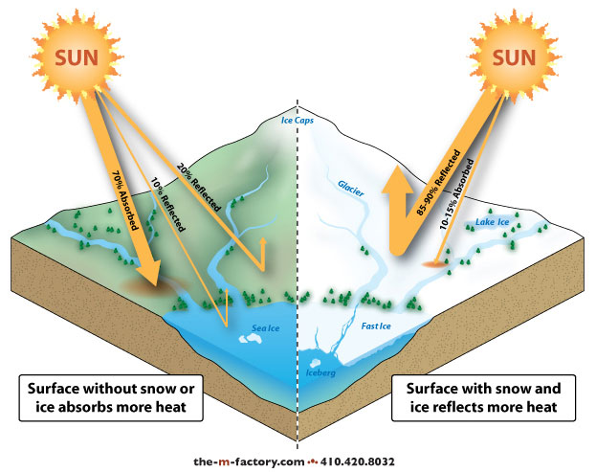
Climate warms
Less snow shorter winters.
Earth’s surface has lower
albedo, more energy is absorbed
The snow-temperature feedback cycle works the opposite way. If more snow
would cover Earth’s surface, reflecting more of the Sun’s radiation. The
Temperature would continue to drop.

Slide 17
The Oxygen Cycle
Oxygen can be found in living things, in the atmosphere, in the water, and in many types of rock.
Most of the oxygen is stored in the rock of the lithosphere.
The oxygen cycles consist of the movement of oxygen gas from living things into the atmosphere through photosynthesis, and then back into living things through cellular respiration.
Ozone
The presence of atmospheric oxygen has led to the formation of ozone and the ozone layer within the stratosphere.
The ozone layer is extremely important to modern life as it absorbs harmful ultraviolet radiation.
As a result, nearly 99% of the UV striking the atmosphere never reaches Earth’s surface.

Slide 18
However, studies indicate that the ozone layer is being depleted. The identification of ozone holes above Antarctica and the Canadian Arctic and the concurrent increase in skin cancers and eye problems associated with ultraviolet radiation are raising much concern among ecologists and the general public.
Most of the problem has been a result of chloroflourocarbons (CFCs) released into the atmosphere.
They are odorless compounds that have been widely used as propellents in aerosol cans and as coolants in air conditioners, refrigerators, and freezers, and are also the waste products in the manufacturing of some foam plastics.
Each CFC released is capable of reacting with and breaking down thousands of ozone molecules (O3).

Slide 19
The rate at which the ozone layer is decreasing has alarmed the world scientific community. Predictions that as much as 60% of the ozone layer will be destroyed by the middle of the century are not uncommon. Many countries have begun to take action on the problem by either banning or reducing freon-based propellants in aerosol cans, and by modifying the methods of producing plastic foam that produce chlorofluorocarbons. Canada has been heavily involved in international negotiations with countries that produce and release ozone-depleting materials. The Montreal Protocol, an international treaty, was signed in 1987 by over 31 members of the United Nations. Although a total ban on ozone-depelting products has not yet been attained, several governments have set up timetables for cutting emissions by specific percentages over a period of time. The first steps have been taken to correct the ozone problem. Whether the treaty will have a major effect or simply slow down a potentially disastrous situation is not yet known.
http://youtu.be/WKrPd-8CJBM

